Slide 1
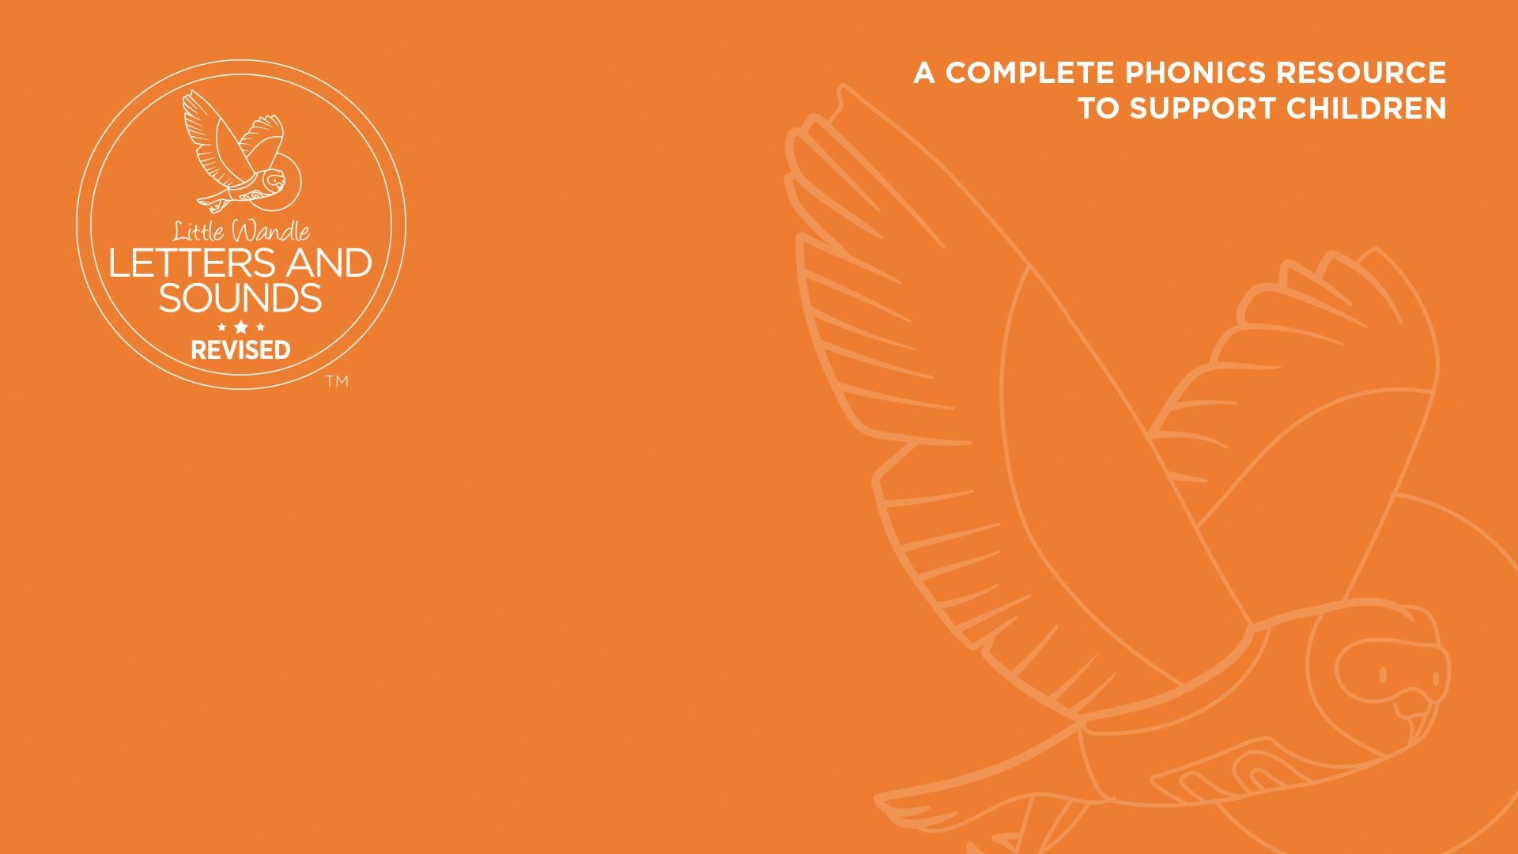
Teach reading: change lives
Parent workshop: Phonics and early reading

Slide 2
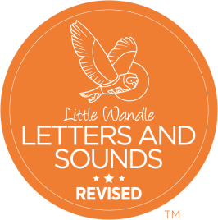
A love of reading is the biggest indicator of future academic success.
OECD (The Organisation for Economic Co-operation and Development)

Slide 3


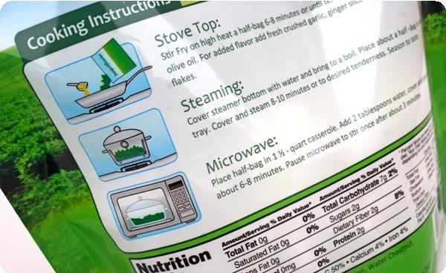
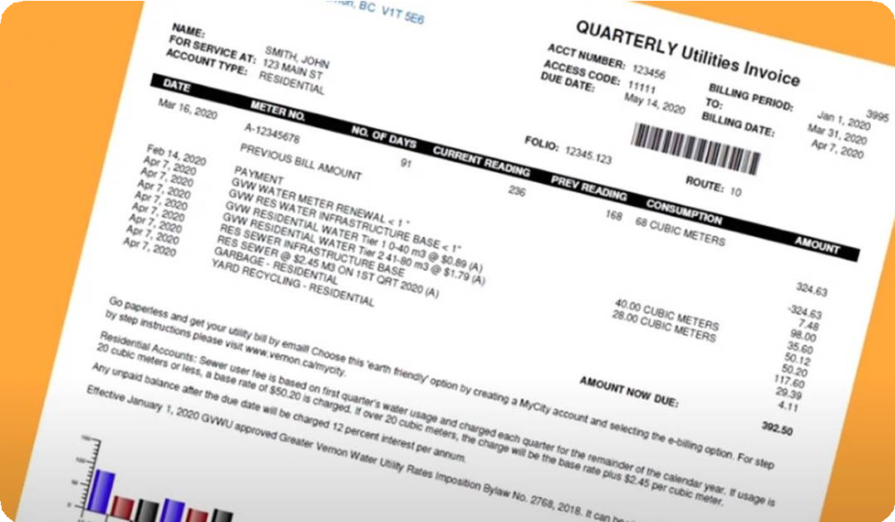
How many times have you already read today?

Slide 4


Phonics

Slide 5
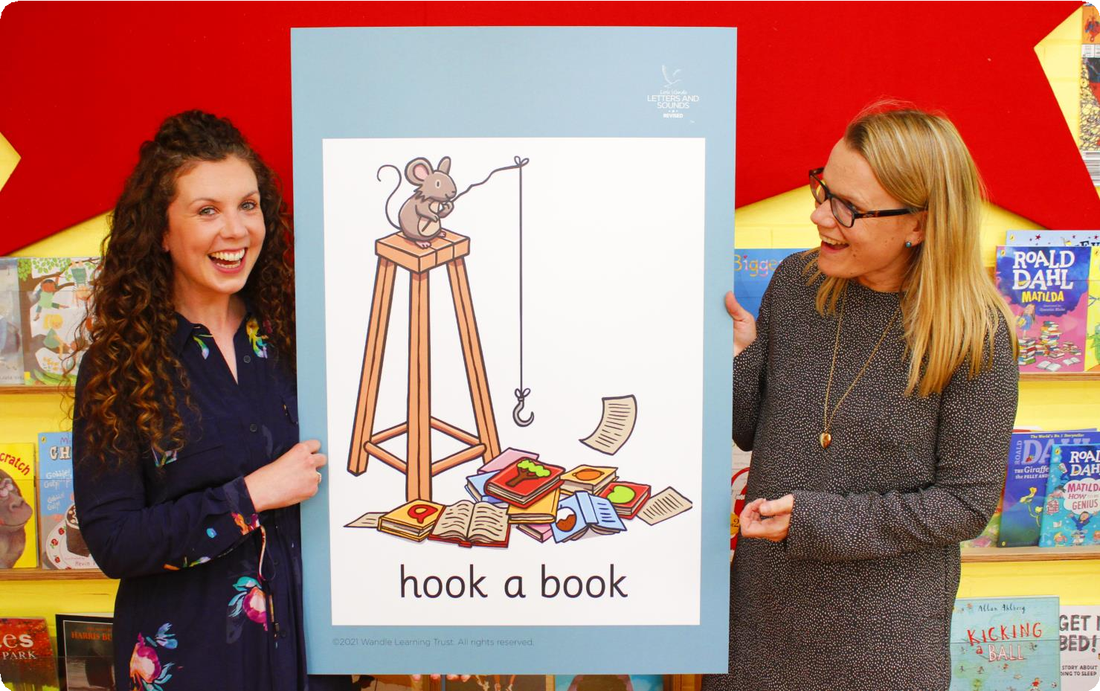
Little Wandle Letters and Sounds Revised
Our school has chosen Little Wandle Letters and Sounds Revised as our
systematic, synthetic phonics (SSP) programme to teach early reading and spelling.

Slide 6
Phonics is:
making connections between the sounds of our spoken words and the letters that are used to write them down.

Slide 7
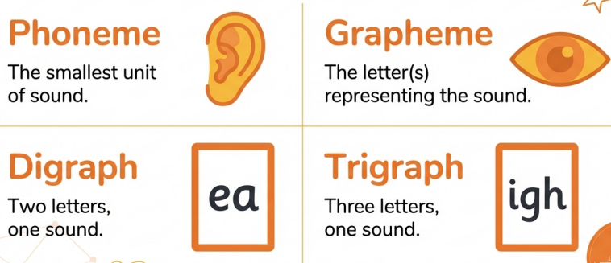
Terminology
Phoneme
Split vowel digraph
Grapheme
Blend
Digraph
Trigraph

Slide 8
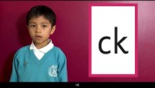

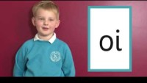
How we say the sounds
Phoneme
Split vowel digraph
Phase 2 Sounds
Phase 2 Sounds
Grapheme
Blend
Digraph
Phase 3 Sounds
Trigraph
For parents | Letters and Sounds

Slide 9
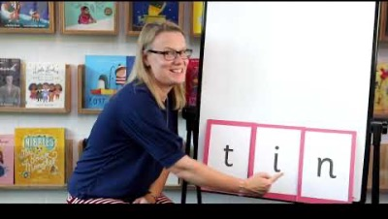
Blending to read words

Slide 10
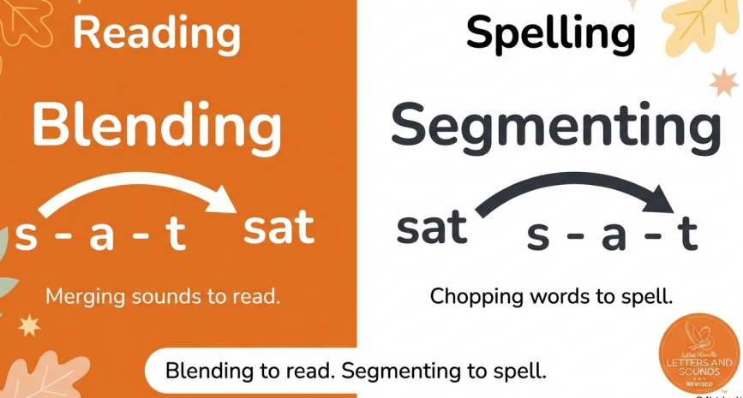
Terminology
Phoneme
Split vowel digraph
Grapheme
Blend
Digraph
Trigraph

Slide 11
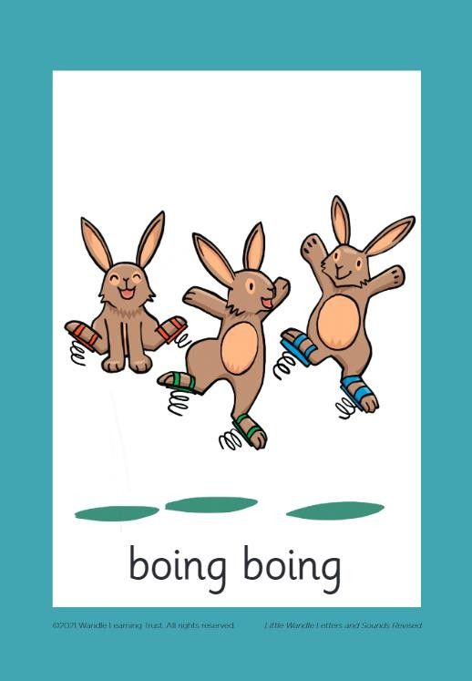

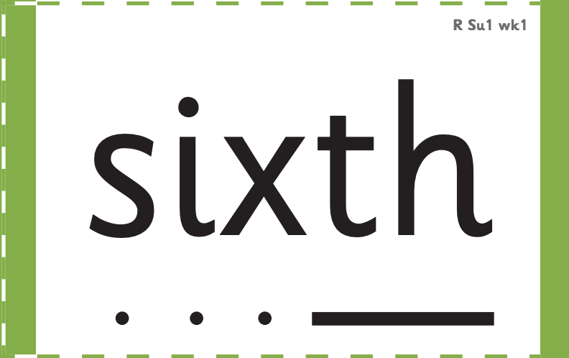

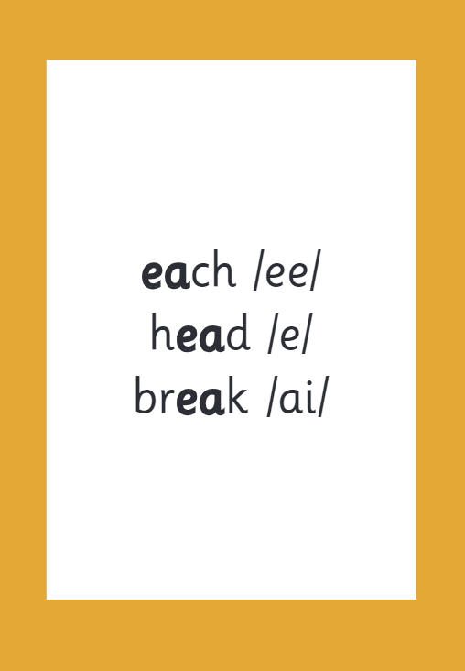

How we make learning stick

Slide 12
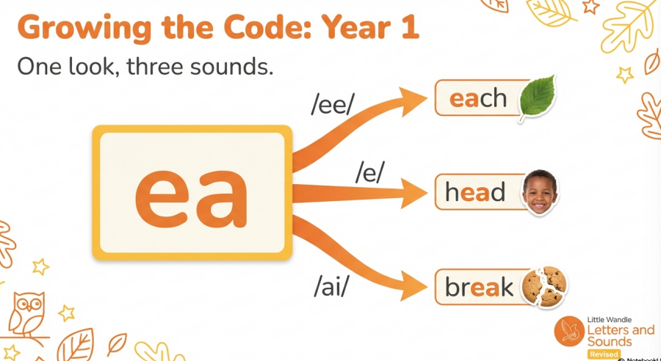

Slide 13
Reading and spelling

Slide 14
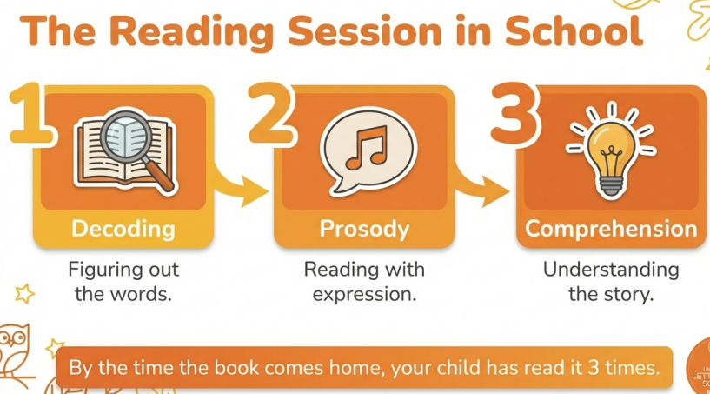

Slide 15
And all the different ways to write the phoneme sh:
shell caption
chef mansion special passion

Slide 16
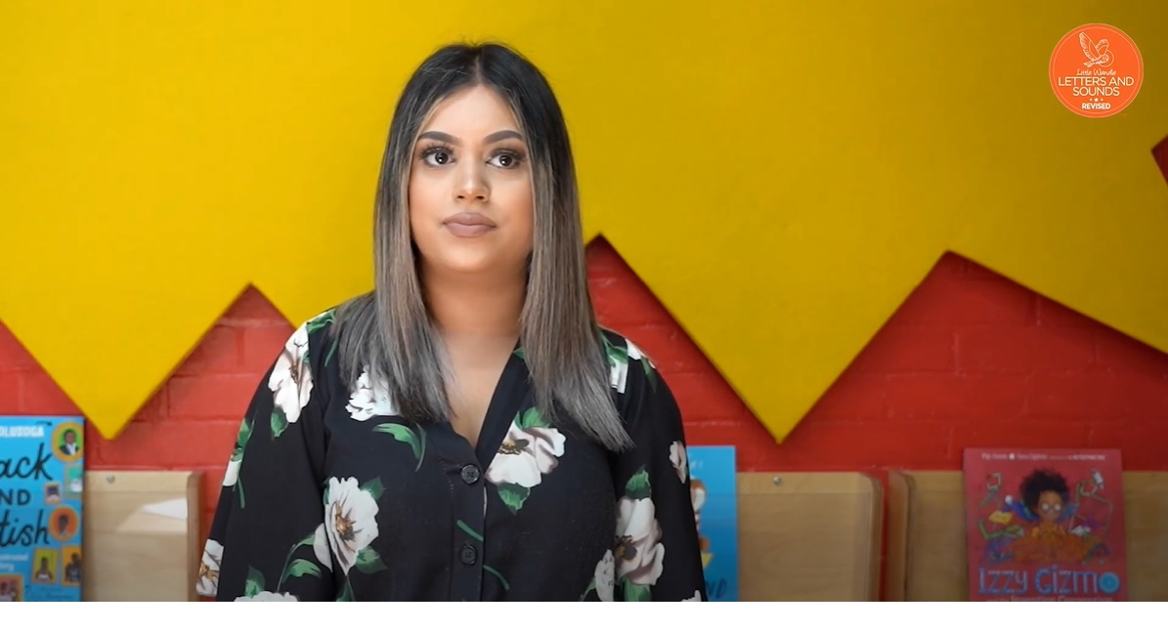
Tricky words

Slide 17



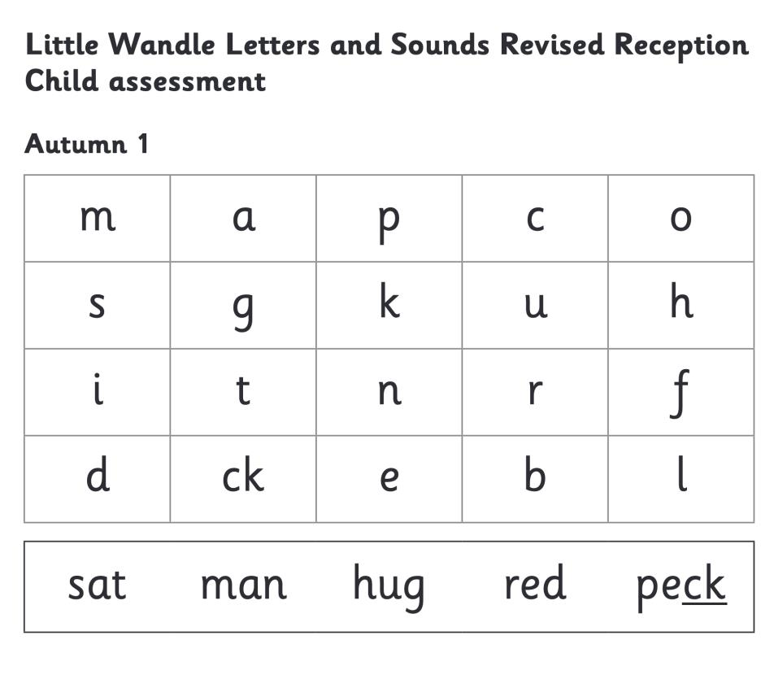
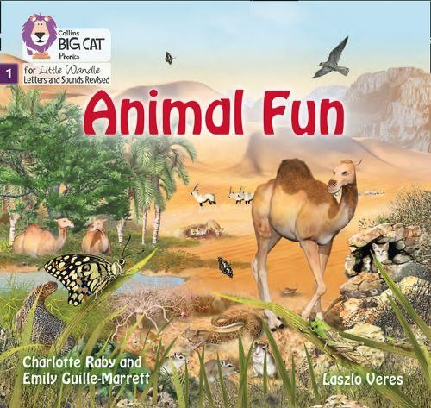

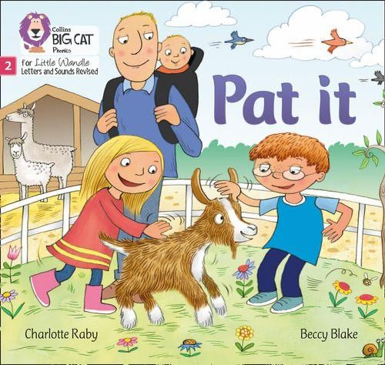

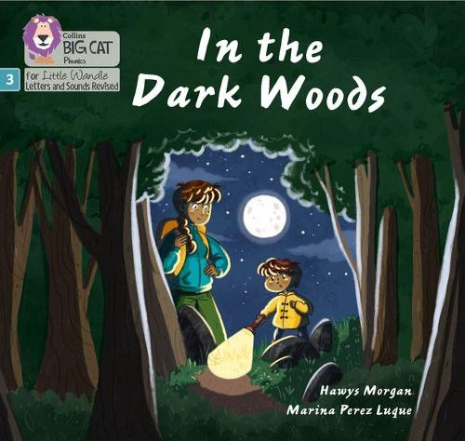
We use assessment to match your child the right level of book

Slide 18

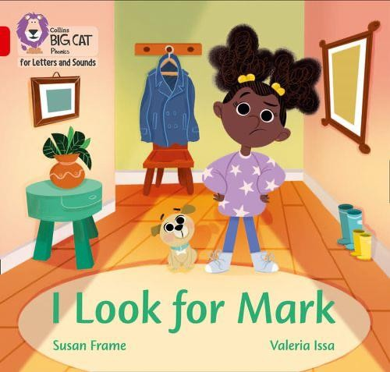

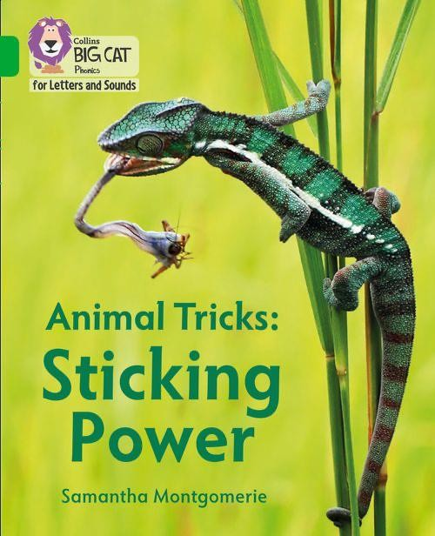

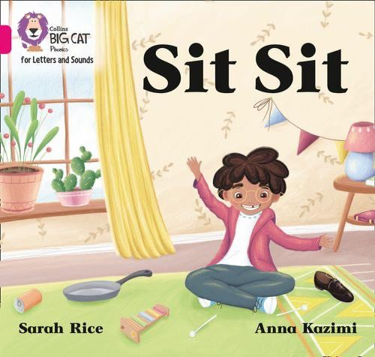
How do we teach reading using books?
Reading practice sessions are:
timetabled three times a week
taught by a trained teacher/teaching assistant
taught in small groups.

Slide 19
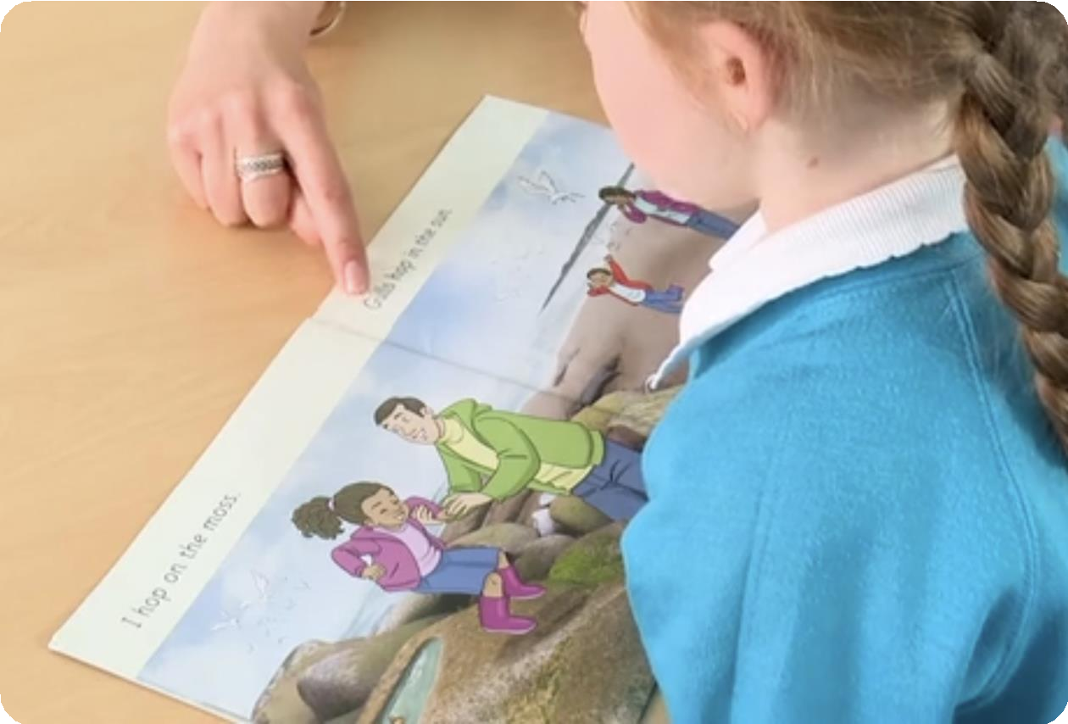
Reading a book at the right level
This means that your child should:
Know all the sounds and tricky words in
their phonics book well
Read many of the words by silent blending (in their head) – their reading will be automatic
Only need to stop and sound out about 5% of the words by the time they bring the book home – but they should be able to do this on their own.

Slide 20

Spelling
Say the word.
Segment the sounds.
Count the sounds.
Write them down.

Slide 21
Reading at home

Slide 22
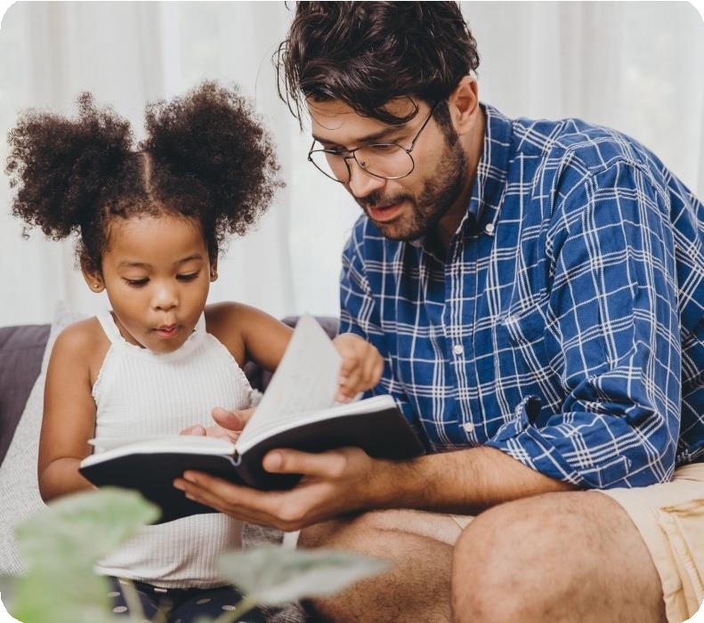
The most important thing you can do is read with your child
Reading a book and chatting had a positive
impact a year later on children’s ability to…
understand words and sentences
use a wide range of vocabulary
develop listening comprehension skills.
The amount of books children were exposed to by age 6 was a positive predictor of their reading ability two years later.
Parental involvement in the development of children’s reading skills: A five-year longitudinal study (2002) Senechal, M. and Lefvre, J

Slide 23


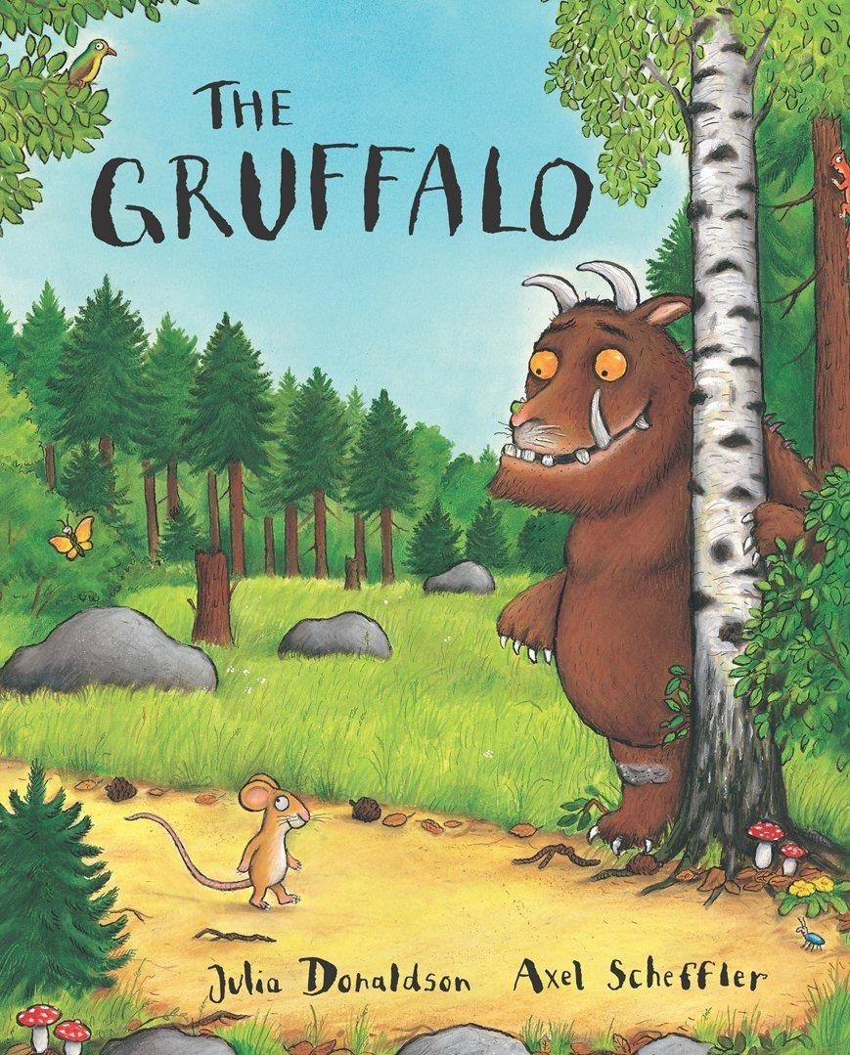

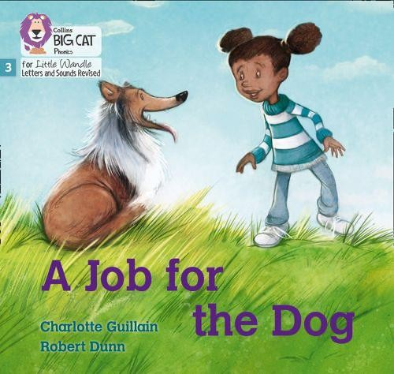
Books going home

Slide 24


Listening to your child read their phonics book
Your child should be able to read their book without your help.
If they can’t read a word read it to
them.
Talk about the book and celebrate their success.

Slide 25

Read to your child
The shared book is for YOU to read:
Make the story sound as exciting as you can by
changing your voice.
Talk with your child as much as you can:
  Introduce new and exciting language
  Encourage your child to use new vocabulary
  Make up sentences together
  Find different words to use
  Describe things you see.

Slide 26
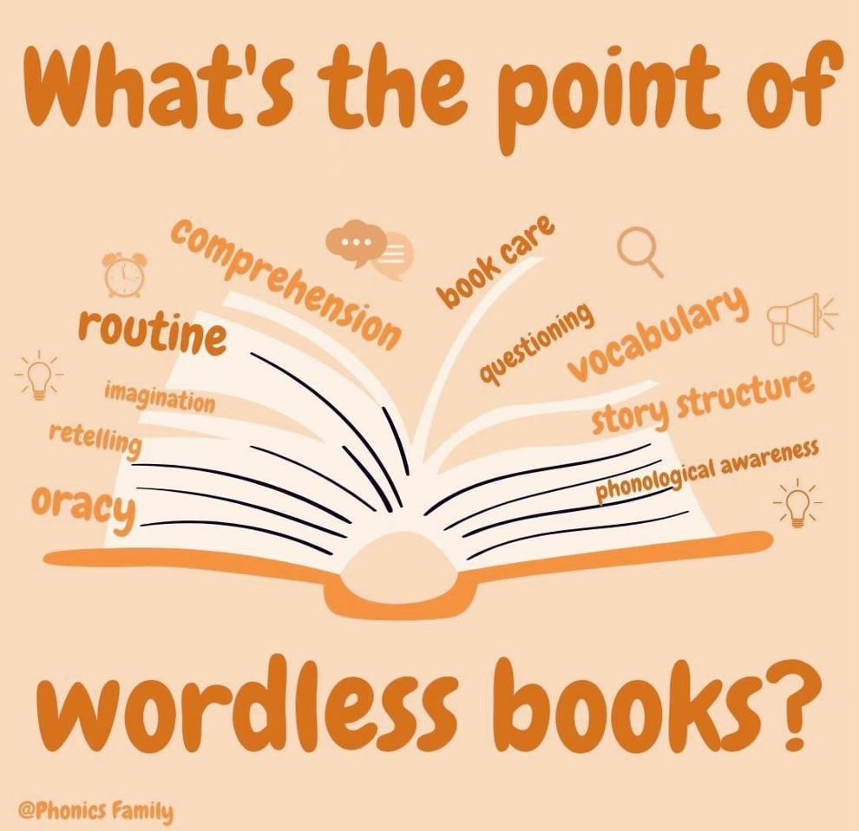

Slide 27
Routine
Receiving a wordles book gives you opportunity to establish a
routine.
Where do you think would be the best place to share our book?
Are you comfortable and ready to look at this book together now?

Slide 28
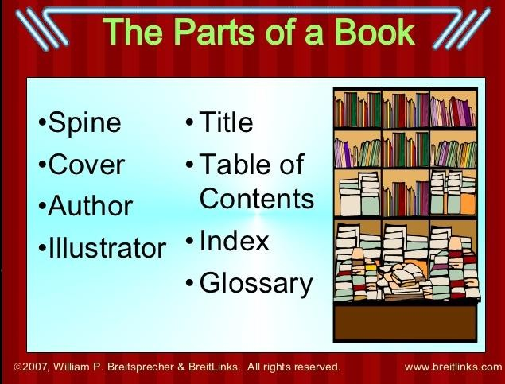
Taking care of a book.
Model how to look after the book sent from school, holding it and turning the pages. Let you child take responsibility of looking after it.

Slide 29
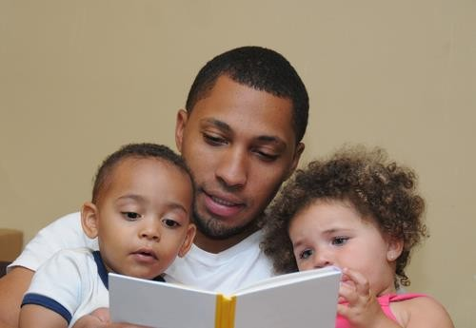
Oracy.
Wordless books help to develop oracy skills in
children and support rich conversations
‘Oral narrative skills are crucial to early literacy development as they assist children in making the transition between oral narrative and written text’ (Collins and Clover 2015)

Slide 30
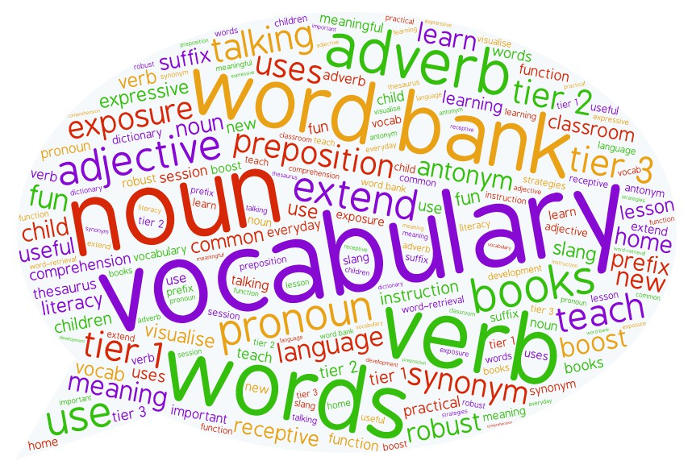
Vocabulary and Phonological Awareness.
Use the books to expand children’s vocabulary. Vocabulary is a key predictor of future academic success.
Prepare them for reading words. Play eye spy or find rhyming words for the pictures.

Slide 31
Comprehension, Retelling and Imagination.
Discussing the book can really impact a child’s
comprehensions skills.
Once they have shared the book several times, can they retell the story in their own words?

Slide 32

Any questions?

