Slide 1






Meet the
Teacher

Slide 2

My Classroom
The atmosphere that I want create in Year Oak Class this year is one of kindness, respect, independence and growth.
Learning in Year 3/4 should be fun, engaging, and challenging, helping children to build strong foundations for UKS2

Slide 3


Year 3/4 Curriculum
Core Subjects:
English (Reading & Writing)
Maths
RE
Broader Subjects:
Science, History, Geography, Art, DT, PE, Computing, Music, Personal Development
Key focus in Year 3/4:
developing independence, building fluency in reading and writing, confidence in maths
Pathways to Write
Pathways to Read
Pathways to Spell

Slide 4
Guided Reading
Guided Reading sessions are three times a week and follow this structure:
  Prediction
  Vocabulary
  Comprehension session

Slide 5
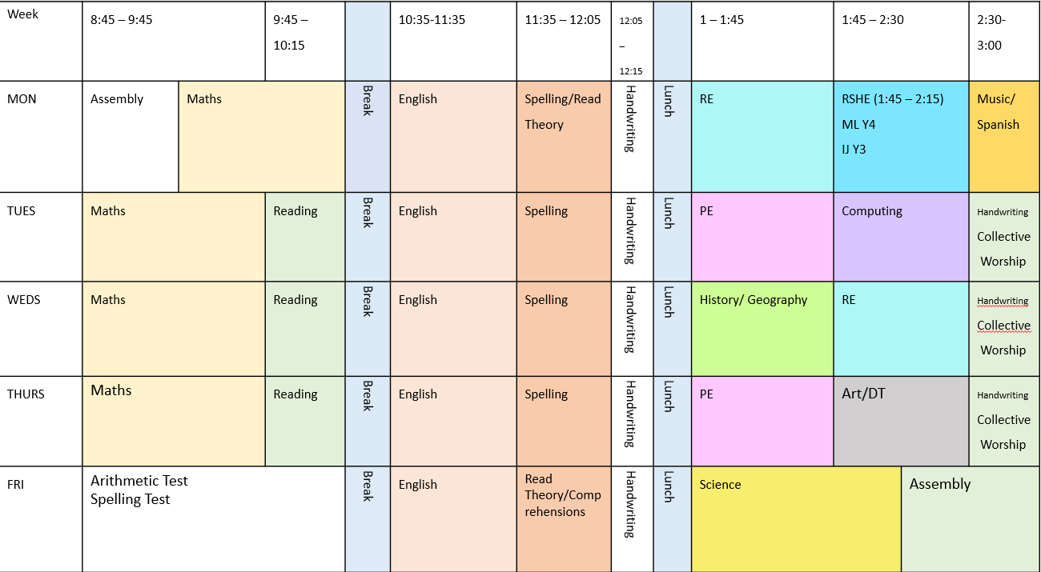
A typical week in Year 3/4

Slide 6
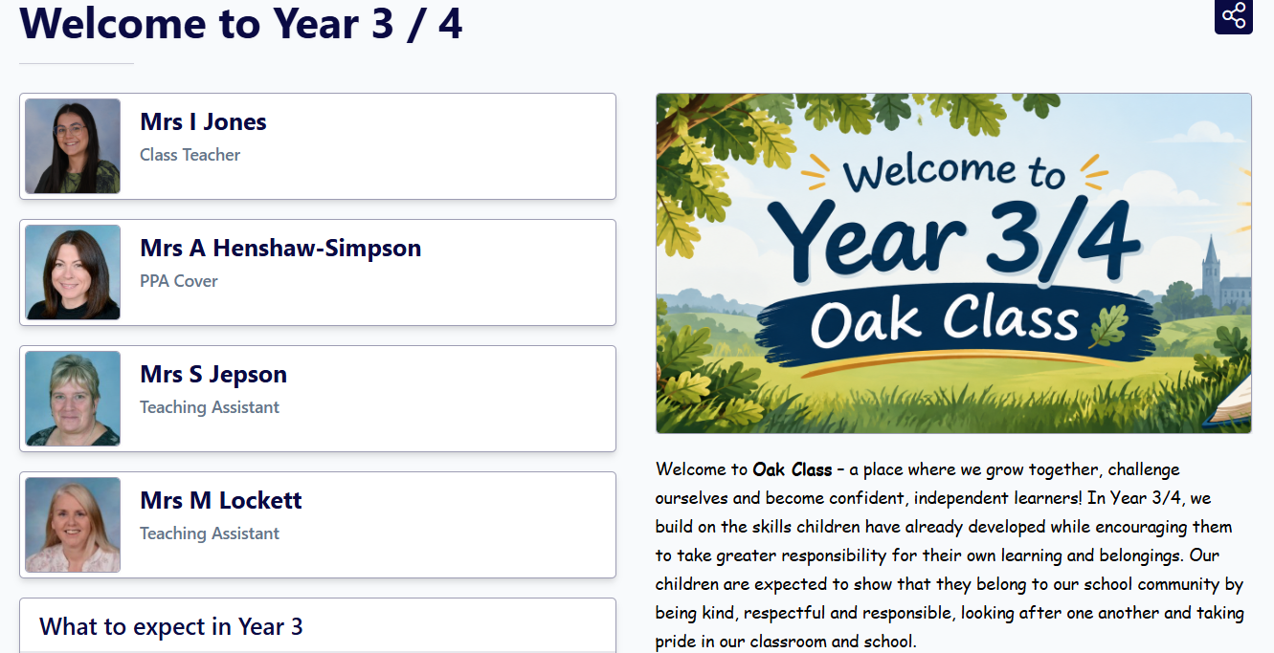
Homework
Reading a minimum of three times a week - please write in diaries
Google Classroom - Spellings, Maths, English

Slide 7
Contact
Mornings: Settling the class
(please pass messages to staff at the door)
After school: Available for a quick chat
Longer conversations: Please email the office to arrange a meeting

Slide 8
How can you support at home?
Encourage curiosity (visits, reading for pleasure, conversations).
Encourage independence (getting themselves dressed, shoe laces, packing their own bags etc).
Praise effort over results.
Daily routines: sleep, healthy snacks, punctuality.

Slide 9


Slide 10


Thank You

