Slide 1

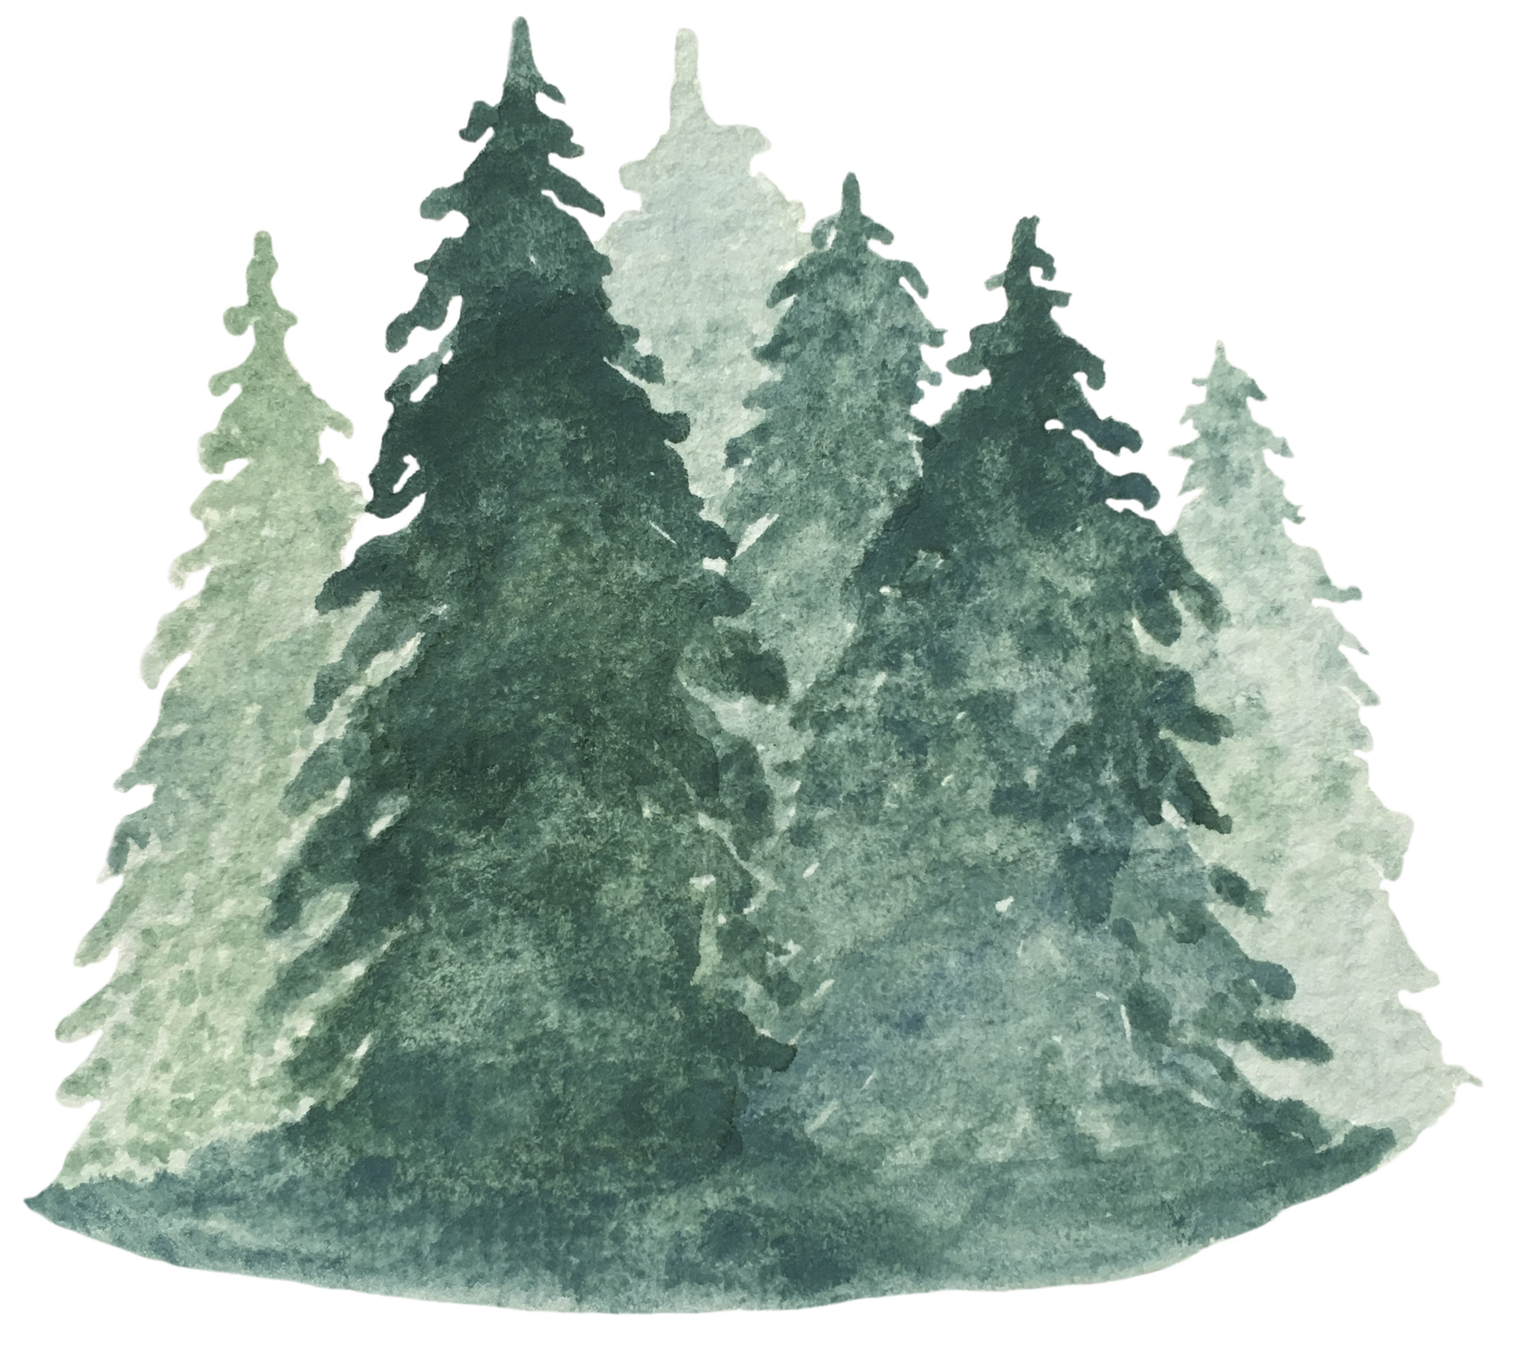

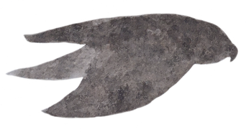


Welcome to Y6 - Hazel Class

Slide 2


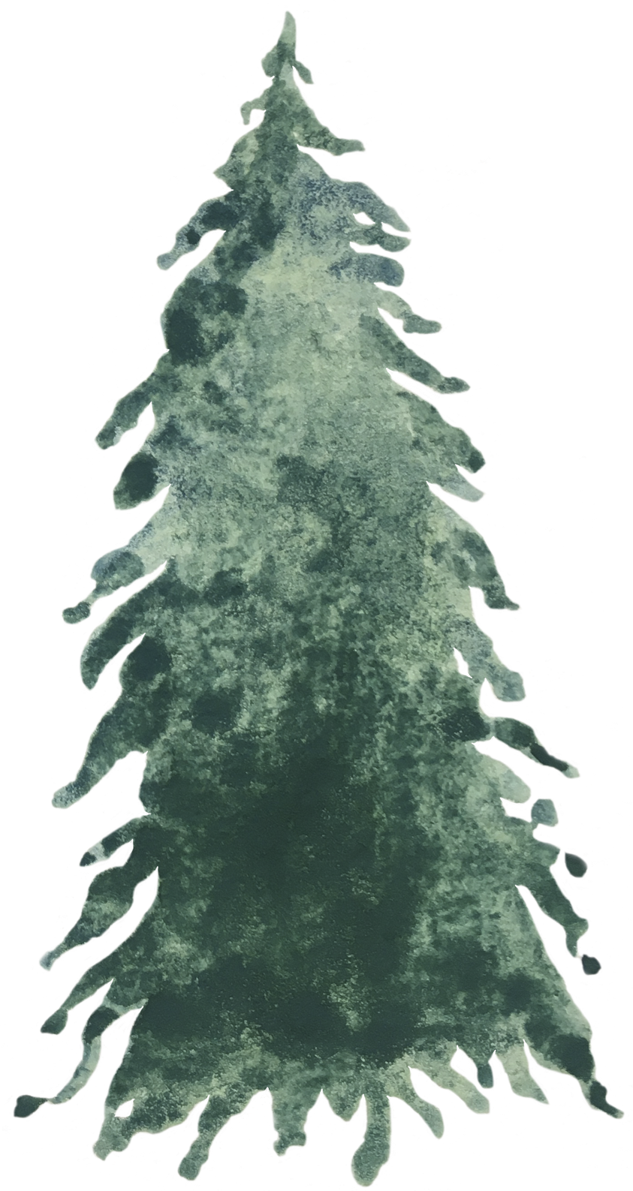
Who works with your child?
Miss. E Crozier
Miss Sankey
Mrs Croughan

Slide 3
Our expectations
  Preparing for Secondary School- being organised and responsible for own learning.
  Being on time, at the right entrance (KS2 door)– ready to learn.
  All children are expected to follow school and class rules.
  Completing all tasks, including homework, to the best of their ability.
  Getting an early night.
  No toys or personal belongings to be bought into school.
  Bring a healthy snack for break time (if you wish) and re-usable bottle of water.

Slide 4
Notices
  PE days are Monday and Thursday, please make sure children are in the appropriate uniform (see website).
  Homework is shared via Google Classroom on Friday, to be handed in for the following Friday.
  Reading Records should be brought in daily, along with your child’s reading skill book.

Slide 5
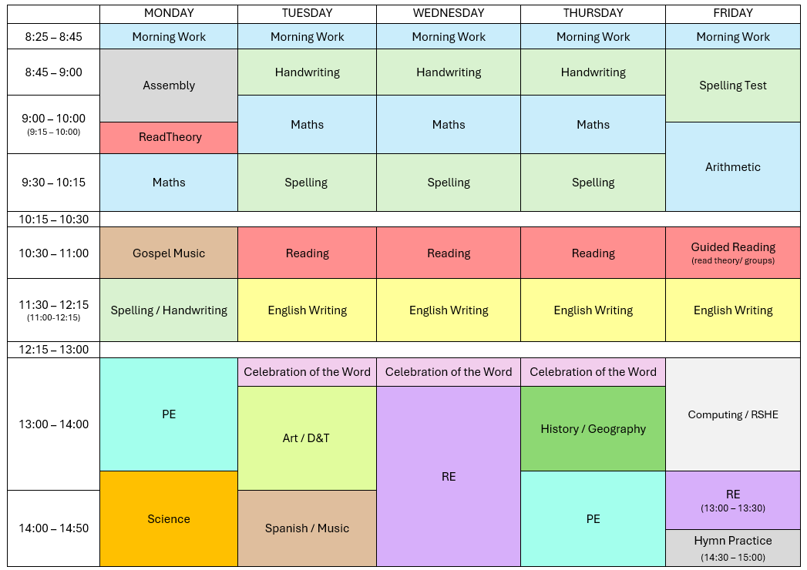

Slide 6
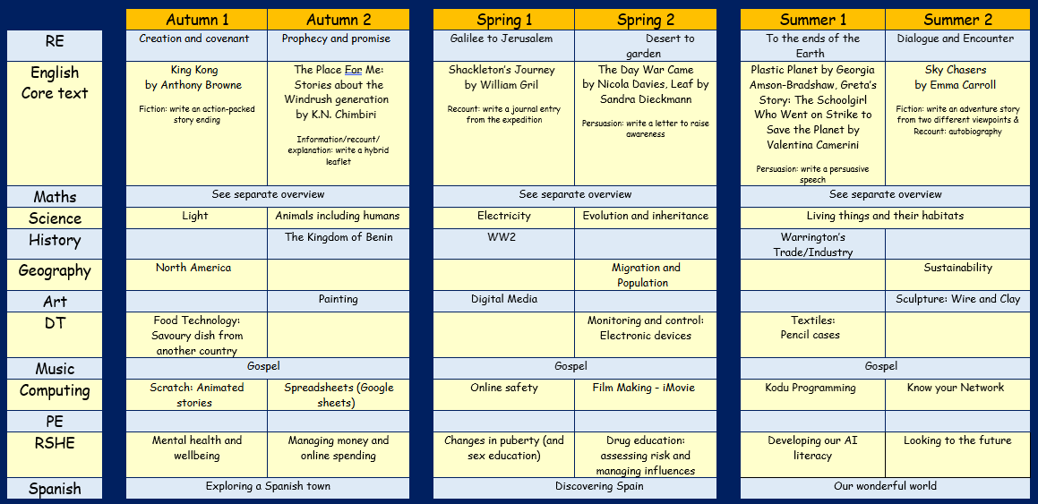

Slide 7
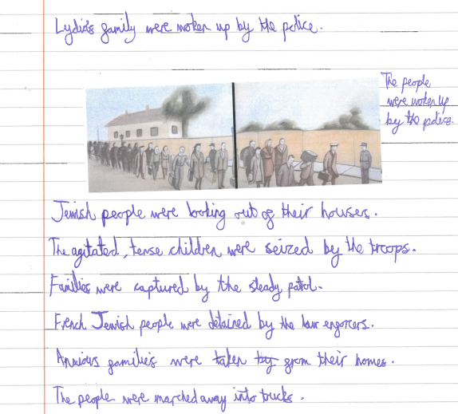
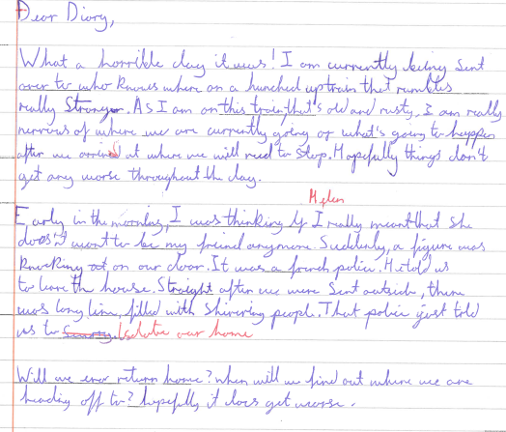
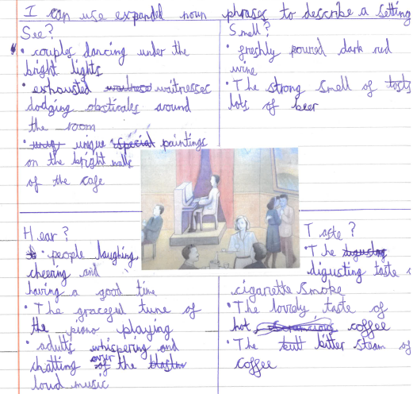

Slide 8
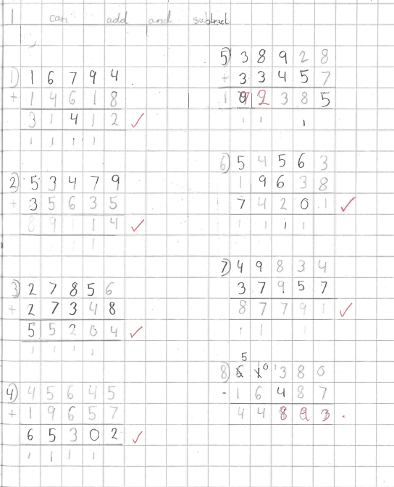
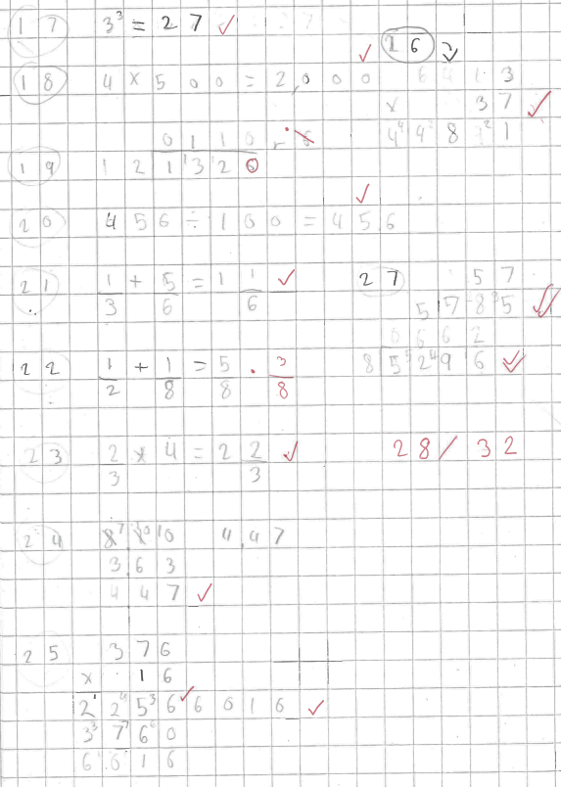

Slide 9
  Reading regularly and asking questions about the content will aid their comprehension skills.
  Encouraging your child with their homework and helping where appropriate.
  Encouraging your child to practice their spellings and arithmetic skills.
  Being supportive through Y6.
  Encouraging your child to discuss worries with their class teacher.
How can you support?

Slide 10
Useful Websites
  https://www.bbc.co.uk/bitesize/learn
(Offers a range of interactive activities, quizzes, and revision materials for English and Maths at KS2 level.)
  Times Table Rockstars
(your child has a login in their reading record)
  https://www.mathsisfun.com/
(Good for revising formal methods of calculation, including fractions)
  Read Theory
(Supports reading comprehension practice. Your child has a login in their reading record)

