Slide 1
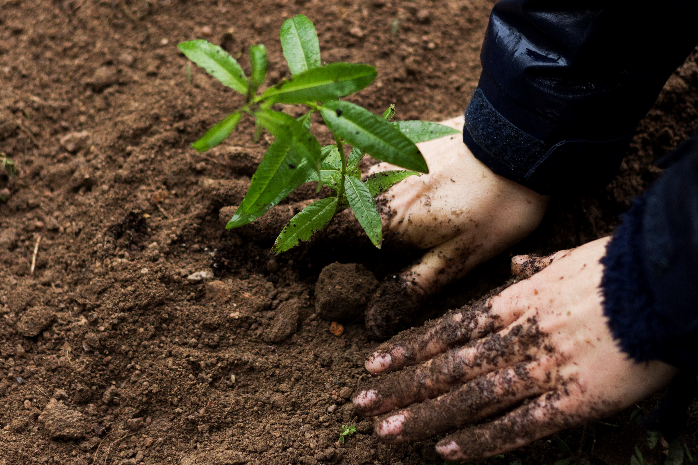
Loving God,
you created the world
for us all to share,
a world of beauty and plenty.
Create in us a desire to live simply, so we can see your generosity.
You gave us responsibility for the earth,
a world of riches and delight.
Help us to live sustainably, so that those
who follow us may enjoy the fruits of your creation
Help us to act in solidarity with all our brothers and
sisters so that we help create a fairer world
Amen
Our LiveSimply prayer
KS2

Slide 2
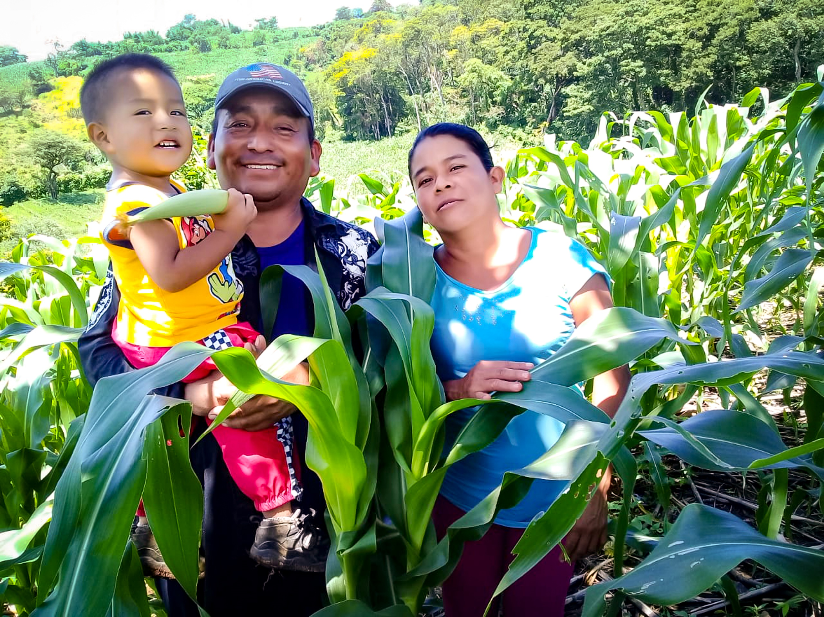
Loving God, you created the world for us all to share,

Slide 3
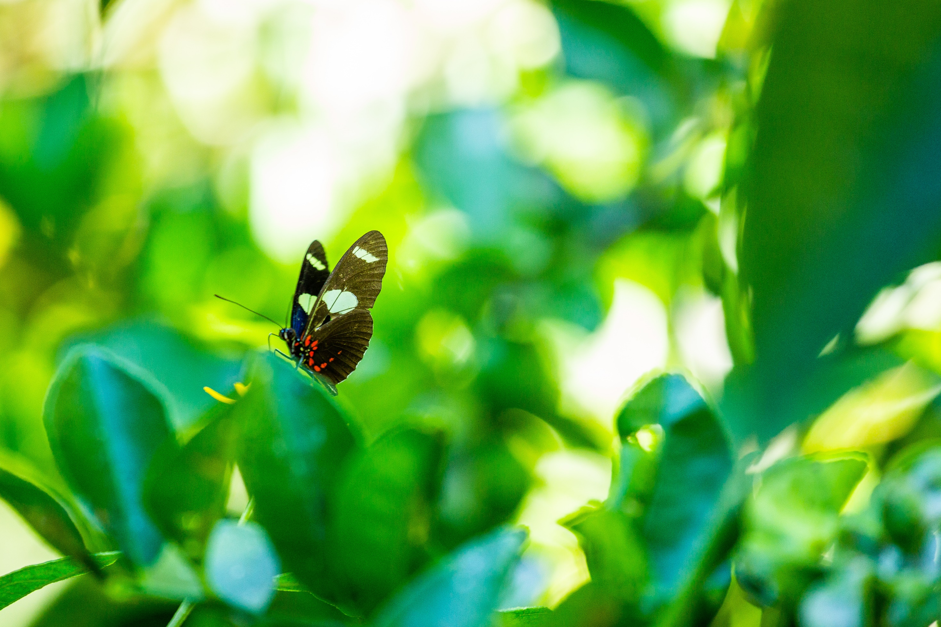
A world of beauty and plenty.

Slide 4
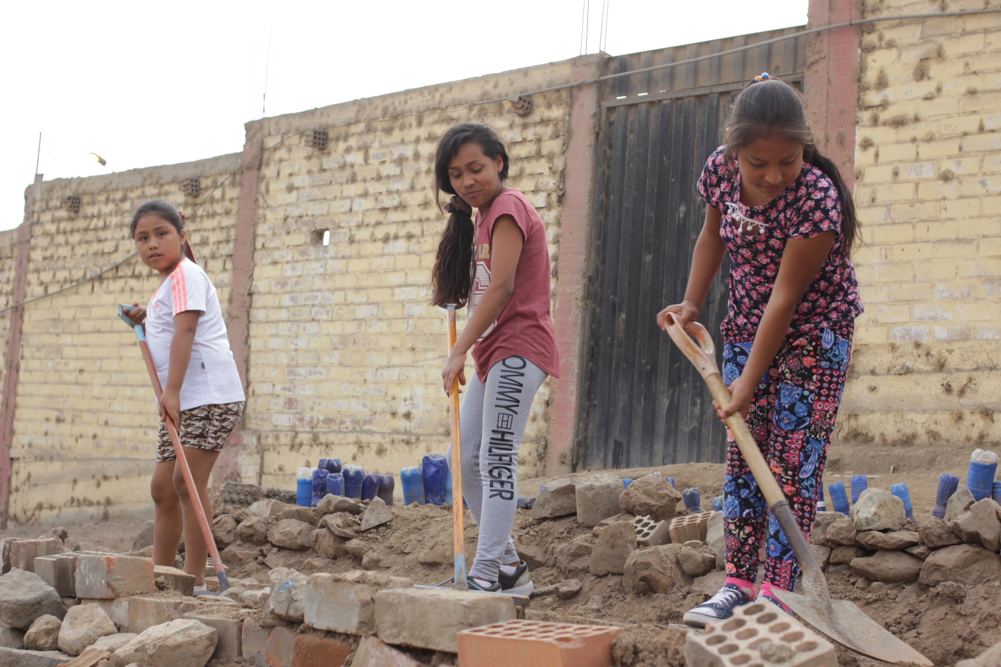
Create in us a desire to live simply, so we can see your generosity.

Slide 5
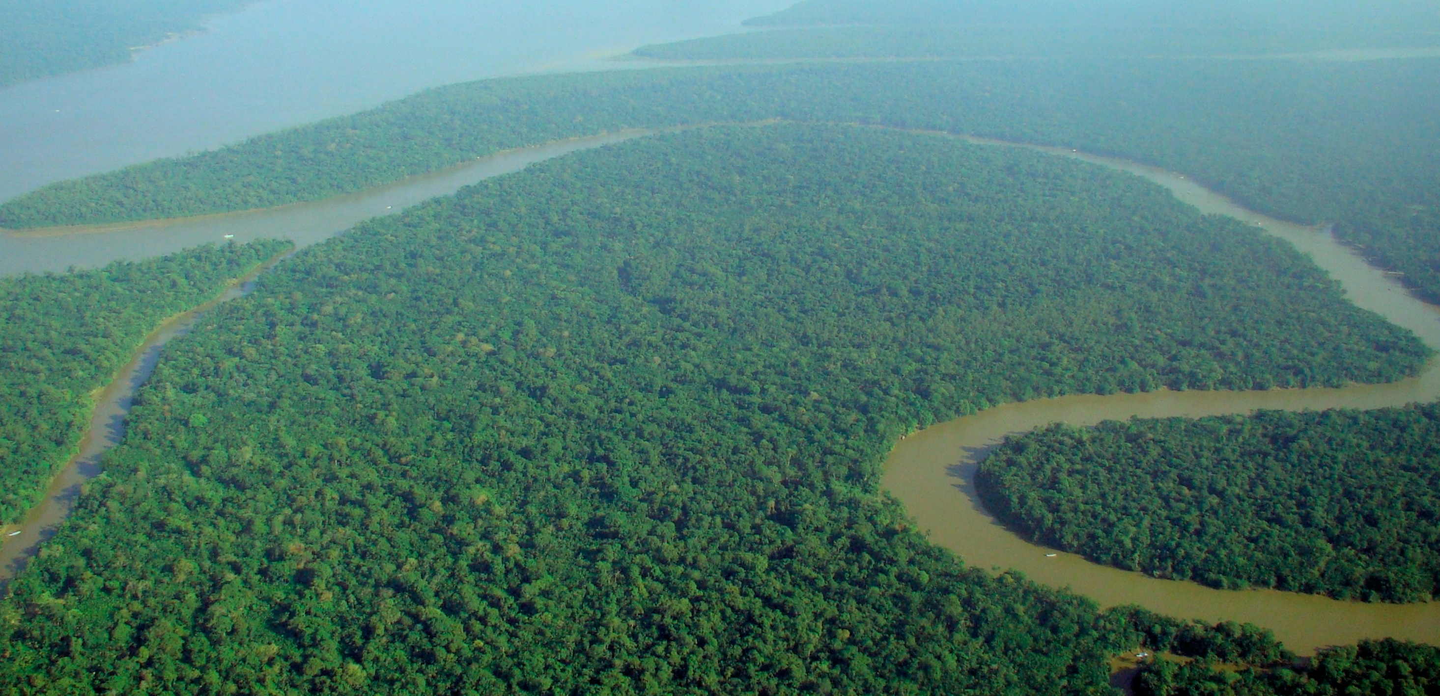
You gave us responsibility for the earth,

Slide 6
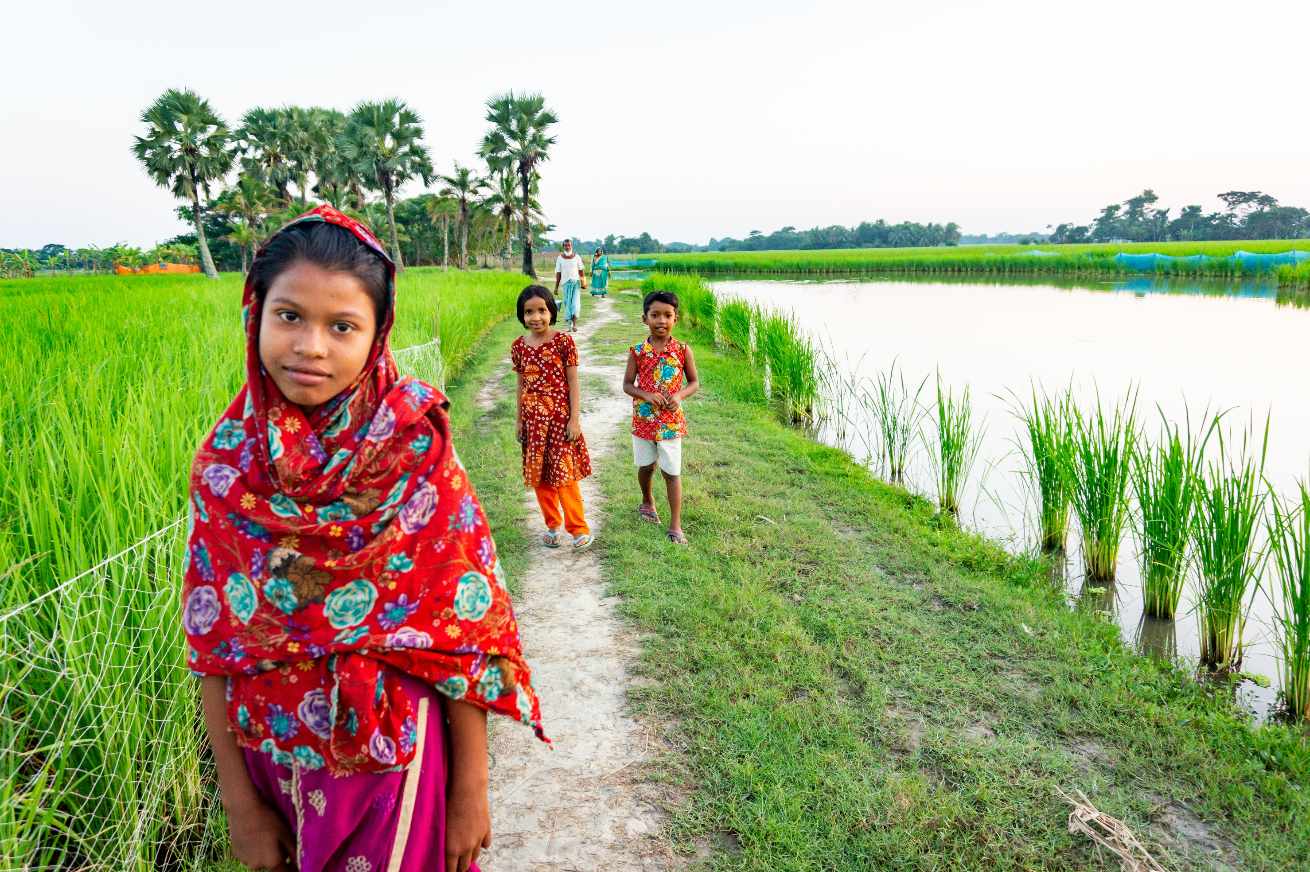
a world of riches and delight.

Slide 7
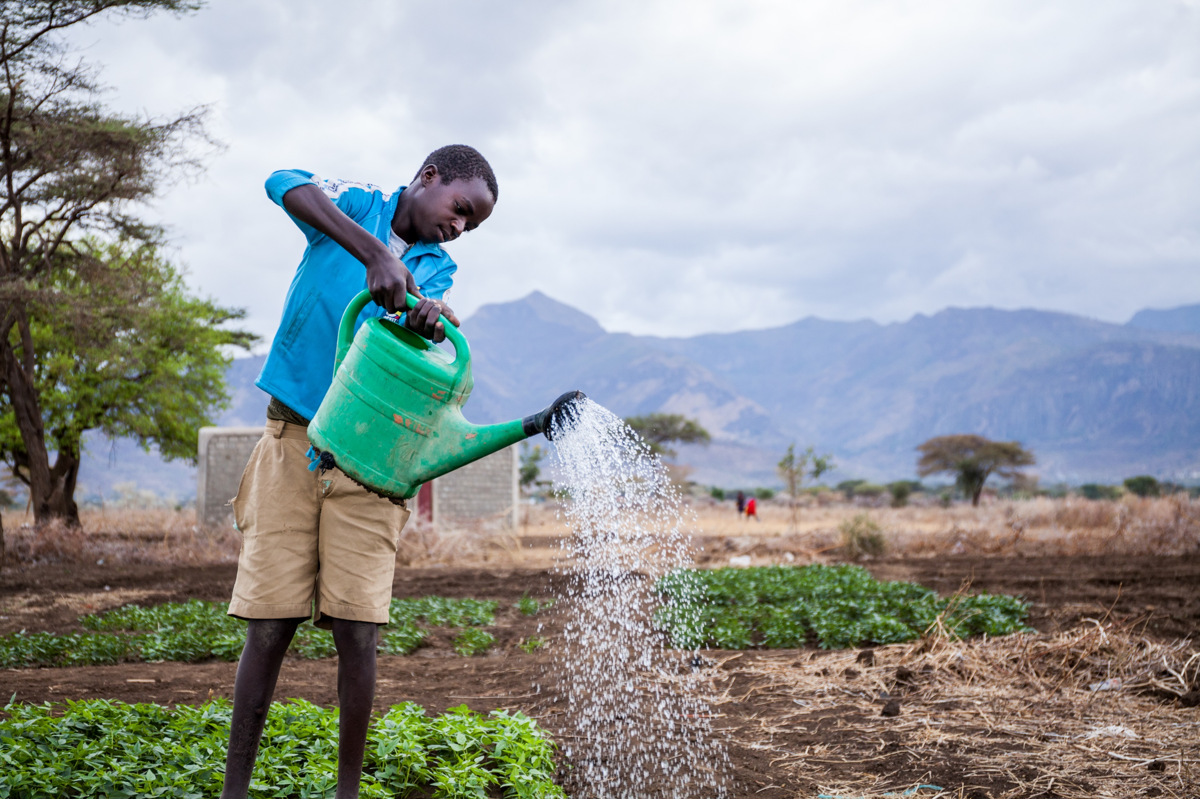
Help us to live sustainably, so that those who follow us may enjoy the fruits of your creation.

Slide 8
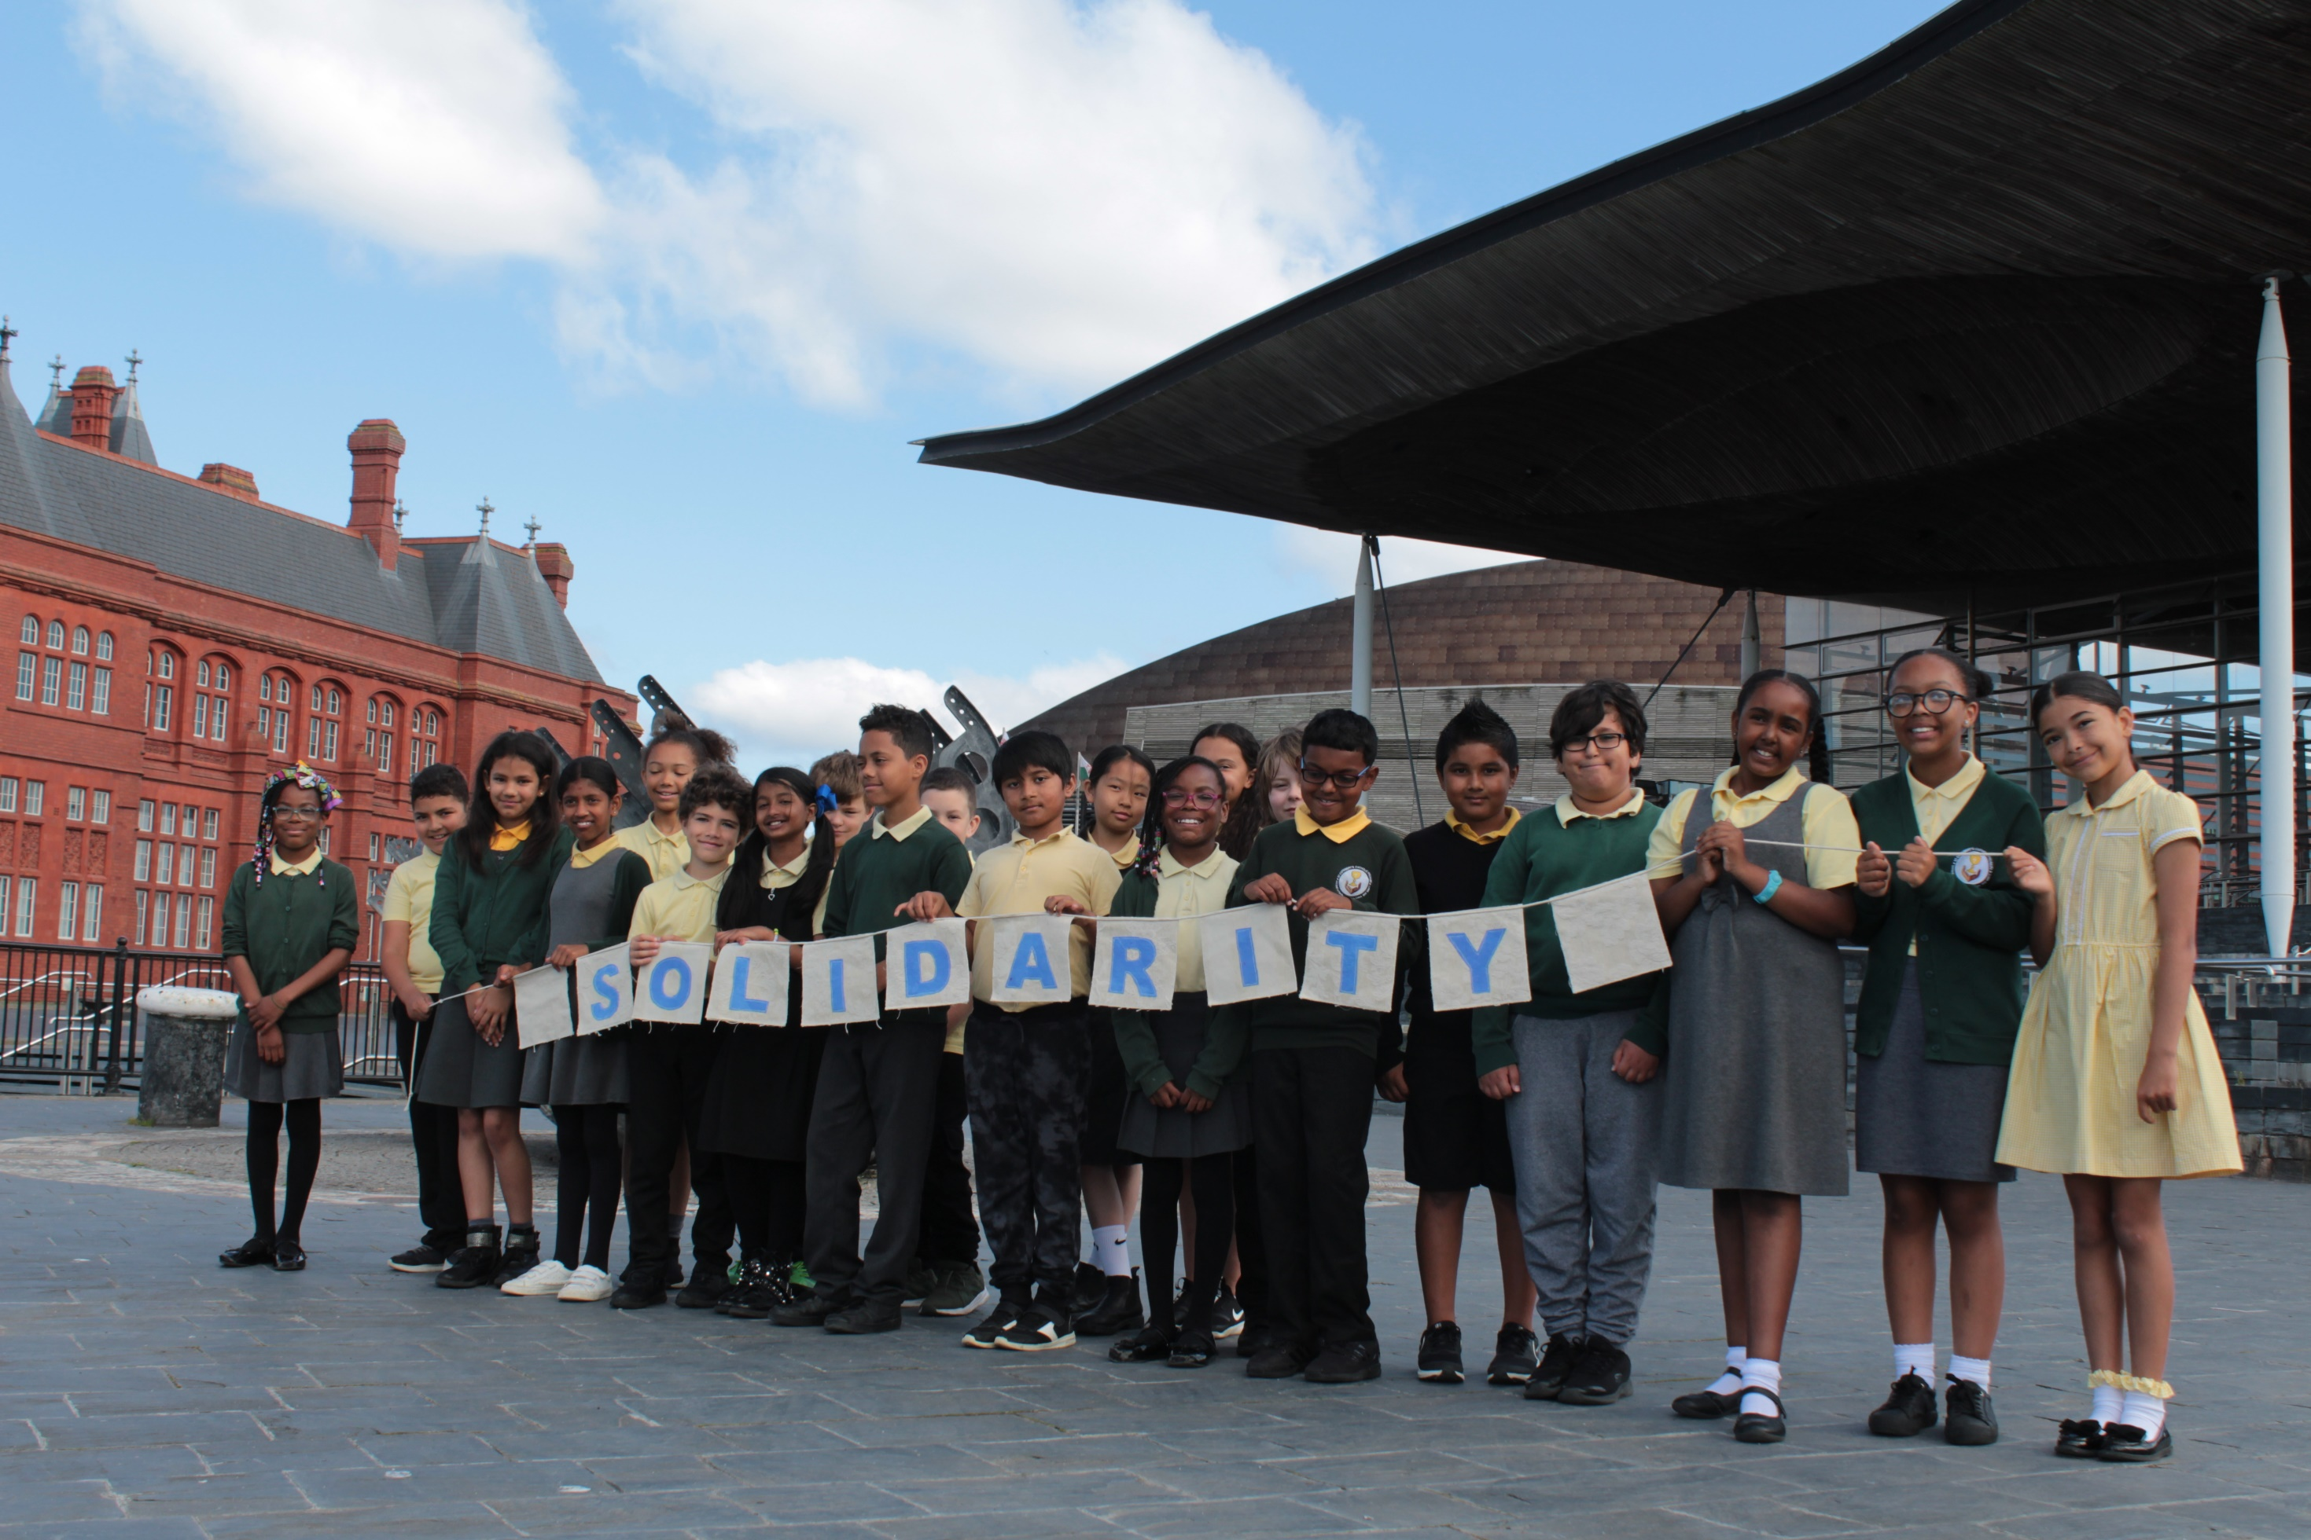
Help us to act in solidarity with all our brothers and sisters

Slide 9
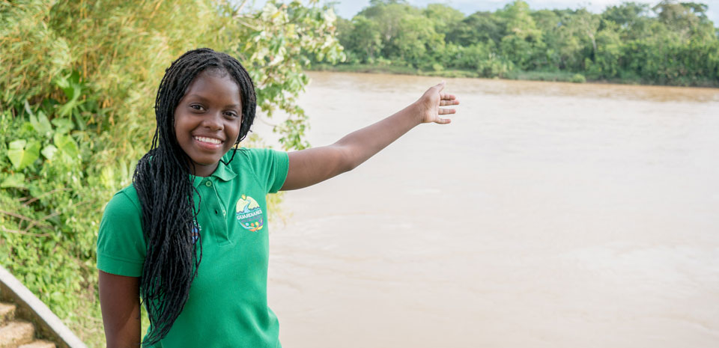
so that we help create a fairer world.
Amen.

