Slide 1
Progression in Mastery
Year 4 Order 4-Digit Numbers
Are you ready for the challenge of ordering 4-digit numbers?
©Deepening Understanding LTD 2019

Slide 2
Let’s do this!
Make as many 3-digit numbers as you can using these numbers.
Now put them in ascending order.
1
2
3
4
5
©Deepening Understanding LTD 2019

Slide 3
Let’s revisit what we should know…
We compare pairs of numbers using the symbols:
< less than, > greater than
and
= equal to
©Deepening Understanding LTD 2019

Slide 4
Let’s learn
When comparing numbers we look at the ______ __________digit first.
It is the one in the ____________ place value column.
Thousands > Hundreds > Tens > Ones
In a _ - _______ number, the ______s is the _____ __________ _______.
Thousands | Hundreds | Tens | Ones
We all say it!
You say it!
I say it!
©Deepening Understanding LTD 2019

Slide 5
Let’s learn
Ordering numbers involves more than two numbers.
When we put them in ascending order, we order them from smallest to greatest.
12, 20, 31, 45…
When we put them in descending order, we order them from greatest to smallest.
45, 31, 20, 12…
©Deepening Understanding LTD 2019

Slide 6
Let’s learn
Ordering numbers involves more than ______ numbers.
When we put them in _________ order, we order them from ______ to ______.
When we put them in _________ order, we order them from ______ to ______.
We all say it!
You say it!
I say it!
©Deepening Understanding LTD 2019

Slide 7
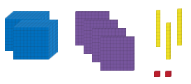
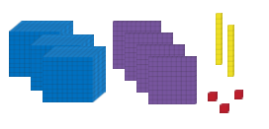
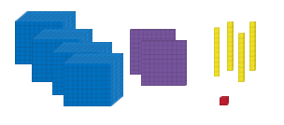
Let’s learn
Ascending order
The most significant digit is the thousands so we look at this first.
Two ______ are smaller than three or four ______ so
______ is the smallest number. Three ______ are smaller than four ______ so ______ is the next smallest number.
You say it!
We all say it!
I say it!
©Deepening Understanding LTD 2019

Slide 8
Let’s learn
Descending order
The most significant digit is the thousands so we look at this first.
Four ______ are greater than three or two ______ so
______ is the greatest number. Three ______ are greater than two ______ so ______ is the next greatest number.
You say it!
We all say it!
I say it!
©Deepening Understanding LTD 2019

Slide 9
Let’s learn
Descending order
Thousands | Hundreds | Tens | Ones
6 8 3 | 7 5 9 | 8 7 5 | 9 1 0
The most significant digit is the _______ .
The number with the greatest number of _______ is _______. The number with the second greatest number of _______ is _______. The number with the smallest number of _______ is _______. In descending order this would be _______, _______, _______.
We all say it!
You say it!
I say it!
©Deepening Understanding LTD 2019

Slide 10
Let’s learn
Ascending order
2,677
3,908
5,435
The most significant digit is the _______ .
The number with the smallest number of _______ is _______.
The number with the second smallest number of _______ is _______.
The number with the greatest number of _______ is _______.
In ascending order this is _______, _______, _______.
We all say it!
You say it!
I say it!
©Deepening Understanding LTD 2019

Slide 11
Let’s develop our learning
Descending order
9,541
6,950
6,389
The number with the greatest number of _______ is _______. _______ and _______ have the same number of _______ so we have to look at the _______.
_______ has the greater number of _______.
In descending order this is _______, _______, _______.
We all say it!
You say it!
I say it!
©Deepening Understanding LTD 2019

Slide 12
Let’s talk
Order the numbers in ascending order…
Explain to your partner how you know!
T | H | T | O
5 4 5 | 6 3 5 | 8 9 8 | 4 1 7
©Deepening Understanding LTD 2019

Slide 13
Let’s talk
Order the numbers in descending order…
Explain to your partner how you know!
T | H | T | O
8 5 8 5 | 7 3 7 3 | 8 7 3 6 | 4 1 7 3
©Deepening Understanding LTD 2019

Slide 14
Let’s talk
Order the numbers in descending order…
Explain to your partner how you know!
T | H | T | O
3 3 3 3 | 2 2 2 2 | 4 5 4 5 | 1 1 9 4
©Deepening Understanding LTD 2019

Slide 15
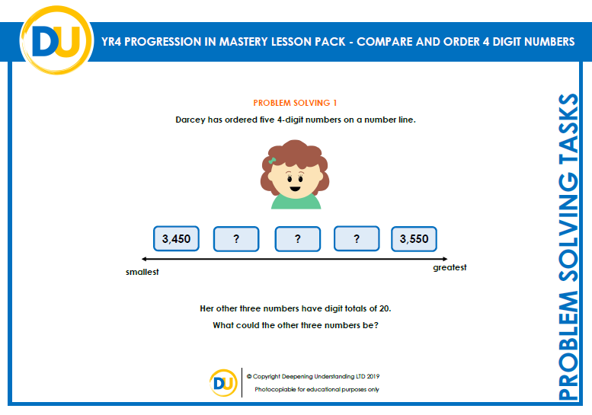
Independent Task
Let’s showcase our learning
©Deepening Understanding LTD 2019

Slide 16
Exit task – Dong Nao Jin
Help Jerry fill in this table so the 4-digit numbers are in descending order.
3 |  | 4
 | 4
3 |  |  | 2
 | 6
 |  | 5
2
©Deepening Understanding LTD 2019

