Slide 2
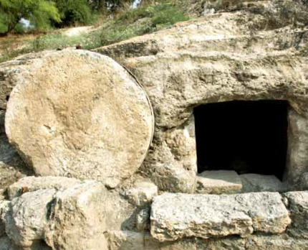
Very early on Sunday morning, Mary of Magdala, Mary the mother of James, and Salome went to Jesus’ tomb. The sun was just coming up.
But you must go and tell Peter and his disciples that Jesus is going to Galilee. You will see him, just as he told you.”
The women came out. They ran away because they were still frightened, and said nothing to anyone because they were afraid.
They had been asking one another about who would roll away the heavy stone across the entrance, but as they came close they could see it had been moved already.
As they went into the tomb they saw a young man dressed in white sitting there. They were amazed.
He said to them, “Don’t be afraid. I know you are looking for Jesus who was crucified. He is risen; he is not here. See, here’s the place where his body was laid.
Based on Mark 16: 2-8
(God’s Story 3)

