Slide 2
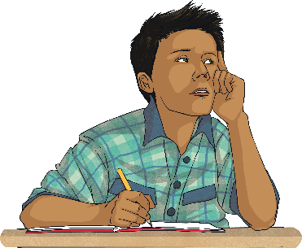
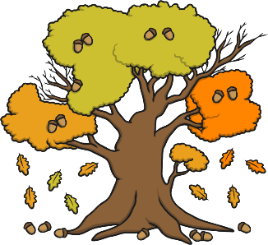
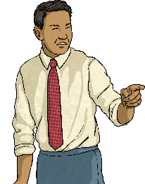
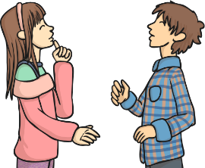
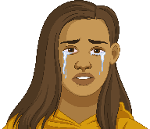
Work with a partner. What letters are missing from these words?
d____ter
n____ty
__thor
__tumn
augh
augh
au
au

Slide 3
What sound do the ‘au’ or ‘augh’ letter strings make?
au
augh
author
autumn
naughty
daughter
Can you think of anymore words containing ‘au’ or ‘augh’ that make an /aw/ sound? Write them on your whiteboard.

Slide 4
How many words could you think of?
caught
naughty
taught
daughter
autumn
clause
cause
astronaut
applaud
author
Did you think of any of these words?

Slide 5
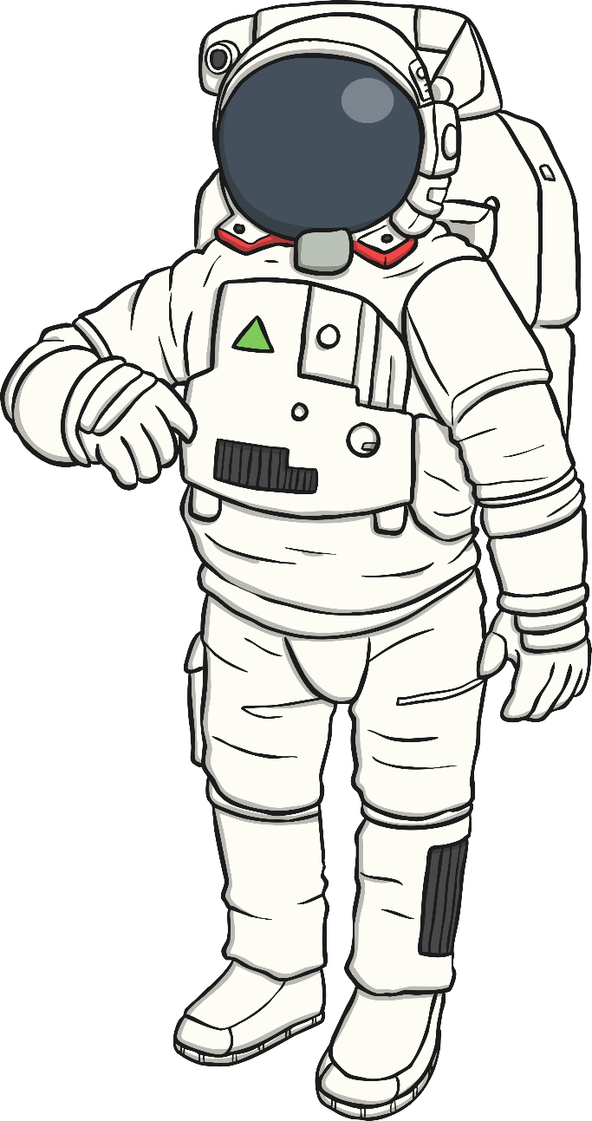
Let’s speed write!
How many times in the next minute can you write…
accurately?
astronaut
Try to write in a cursive style to help you write at a faster pace!
Start
1:00
1:00
0:59
0:58
0:57
0:56
0:55
0:54
0:53
0:52
0:51
0:50
0:49
0:48
0:47
0:46
0:45
0:44
0:43
0:42
0:41
0:40
0:39
0:38
0:37
0:36
0:35
0:34
0:33
0:32
0:31
0:30
0:29
0:28
0:27
0:26
0:25
0:24
0:23
0:22
0:21
0:20
0:19
0:18
0:17
0:16
0:15
0:14
0:13
0:12
0:11
0:10
0:09
0:08
0:07
0:06
0:05
0:04
0:03
0:02
0:01
Times up!

Slide 6
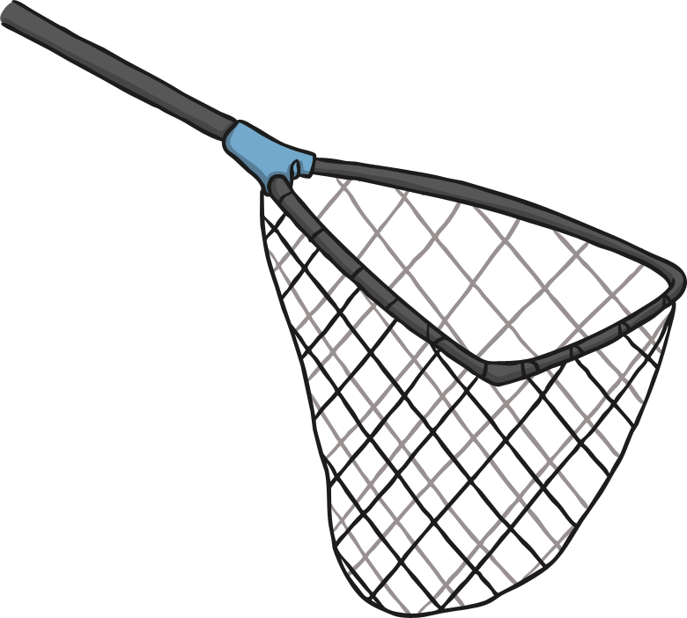
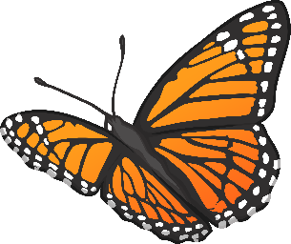
Let’s speed write!
How many times in the next minute can you write…
accurately?
caught
Try to write in a cursive style to help you write at a faster pace!
Start
1:00
1:00
0:59
0:58
0:57
0:56
0:55
0:54
0:53
0:52
0:51
0:50
0:49
0:48
0:47
0:46
0:45
0:44
0:43
0:42
0:41
0:40
0:39
0:38
0:37
0:36
0:35
0:34
0:33
0:32
0:31
0:30
0:29
0:28
0:27
0:26
0:25
0:24
0:23
0:22
0:21
0:20
0:19
0:18
0:17
0:16
0:15
0:14
0:13
0:12
0:11
0:10
0:09
0:08
0:07
0:06
0:05
0:04
0:03
0:02
0:01
Times up!

Slide 7
Let’s speed write!
How many times in the next minute can you write…
accurately?
applaud
Try to write in a cursive style to help you write at a faster pace!
Start
1:00
1:00
0:59
0:58
0:57
0:56
0:55
0:54
0:53
0:52
0:51
0:50
0:49
0:48
0:47
0:46
0:45
0:44
0:43
0:42
0:41
0:40
0:39
0:38
0:37
0:36
0:35
0:34
0:33
0:32
0:31
0:30
0:29
0:28
0:27
0:26
0:25
0:24
0:23
0:22
0:21
0:20
0:19
0:18
0:17
0:16
0:15
0:14
0:13
0:12
0:11
0:10
0:09
0:08
0:07
0:06
0:05
0:04
0:03
0:02
0:01
Times up!

Slide 8
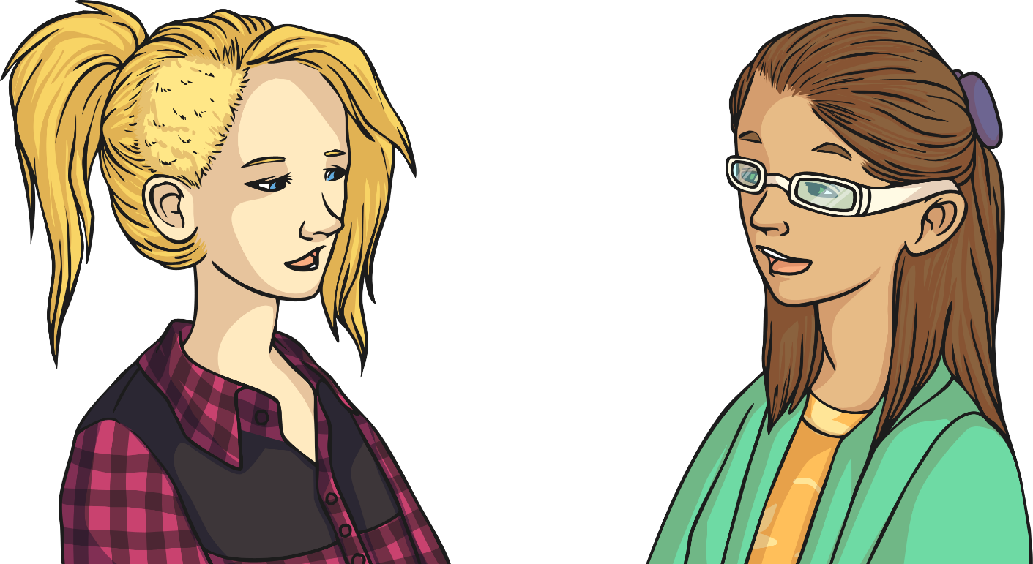
Here are your spelling words for this week.
Work hard to practise the spelling pattern of how to create an /aw/ sound using ‘au’ or ‘augh’.

