Slide 1
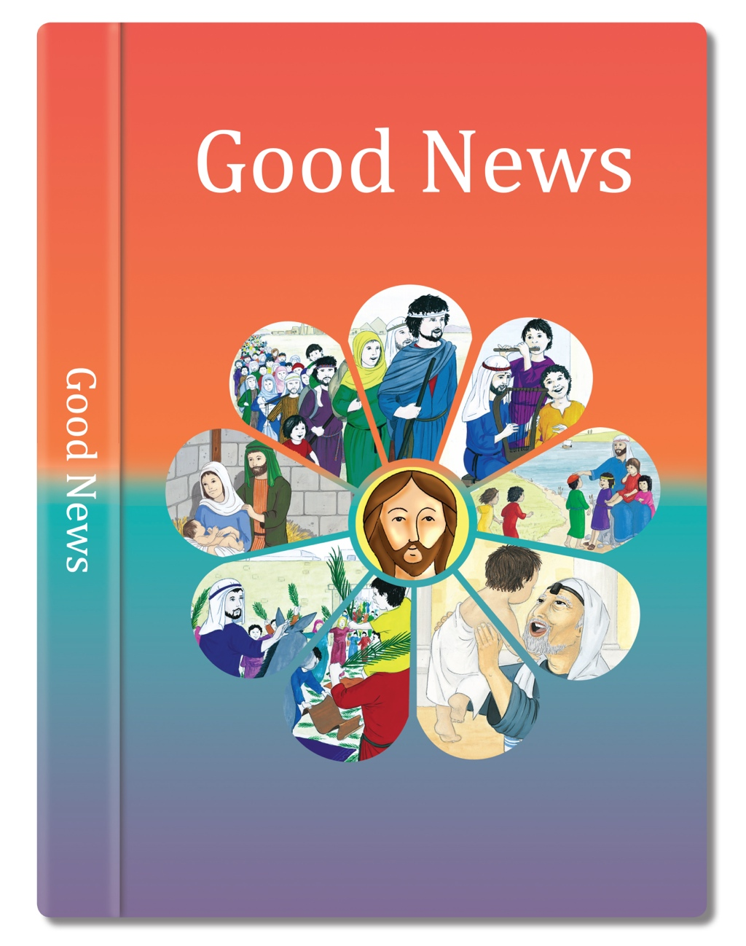

Slide 2
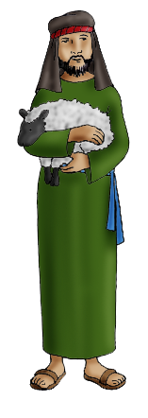
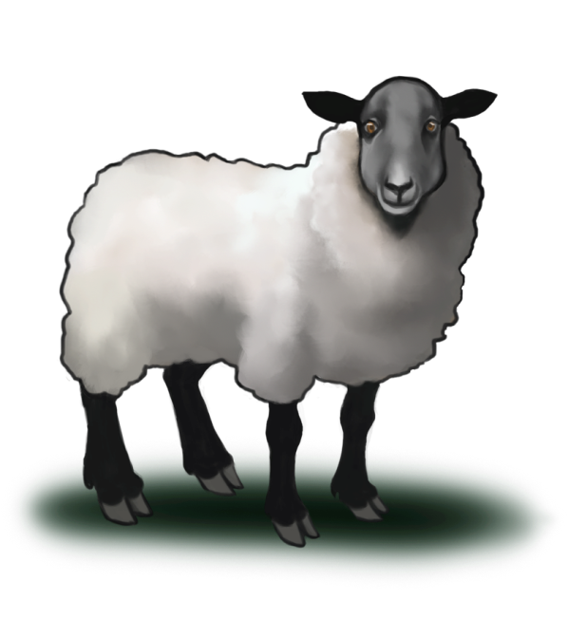
One day Jesus said, “Suppose one of you has a hundred sheep and loses one of them.
“It’s like that with people,” Jesus told them.
“If ninety-nine people stay close to God that’s good.
What do you do? You leave the other ninety-nine sheep grazing on the hillside and go looking for the one that got lost until you find it.
But if one who has turned away from God and done something wrong says sorry and comes back to God, then that is a reason to celebrate.
When you find it, you are so happy that you put it on your shoulders and carry it back home.
God is like the good shepherd, always searching for the lost sheep, looking out the person who has turned away.”
Then you call your friends and neighbours together.
“I am so happy,” you say, “because I have found my lost sheep. Let’s celebrate!”
Based on Luke 15: 3-7
God’s Story 3

