Slide 1
Romero cross activity

Slide 2
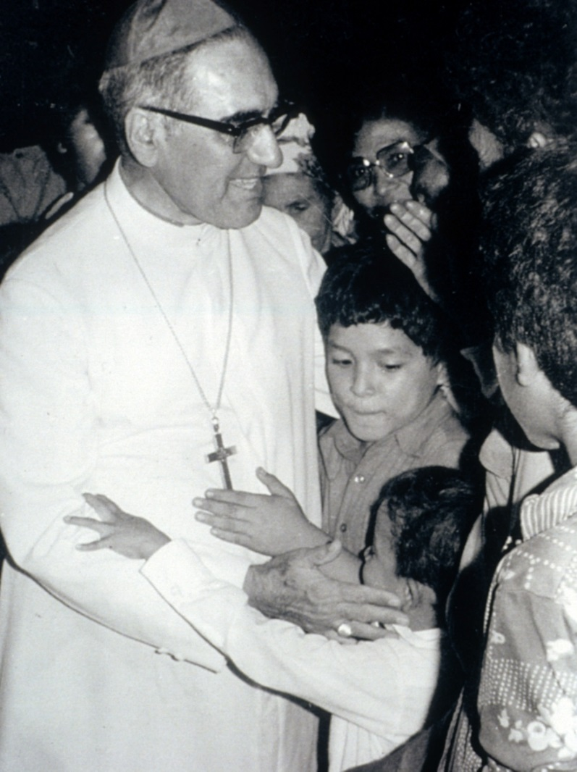
Who was Romero?
A special man
Archbishop of San Salvador
Stood up for poor communities in El Salvador
Spoke out against inequality and injustice
Notes:
Romero was a special man, who stood up for poor communities. In El Salvador there was much inequality - a few families were very rich and owned lots of land but most people were poor and earned very little. People became angry at this unfairness. Many people, like Romero, spoke out against what was happening. But the rich were powerful – if people complained they were put in prison or even killed.
Even so, Romero stood alongside his people and continued to speak out against injustice. On 24 March 1980, Romero was killed while saying Mass.
Romero is remembered for his courage, his faith and, above all, his great love for the poor. Romero still inspires people today, and CAFOD continues to support partners in El Salvador, working to overcome poverty and injustice.

Slide 3
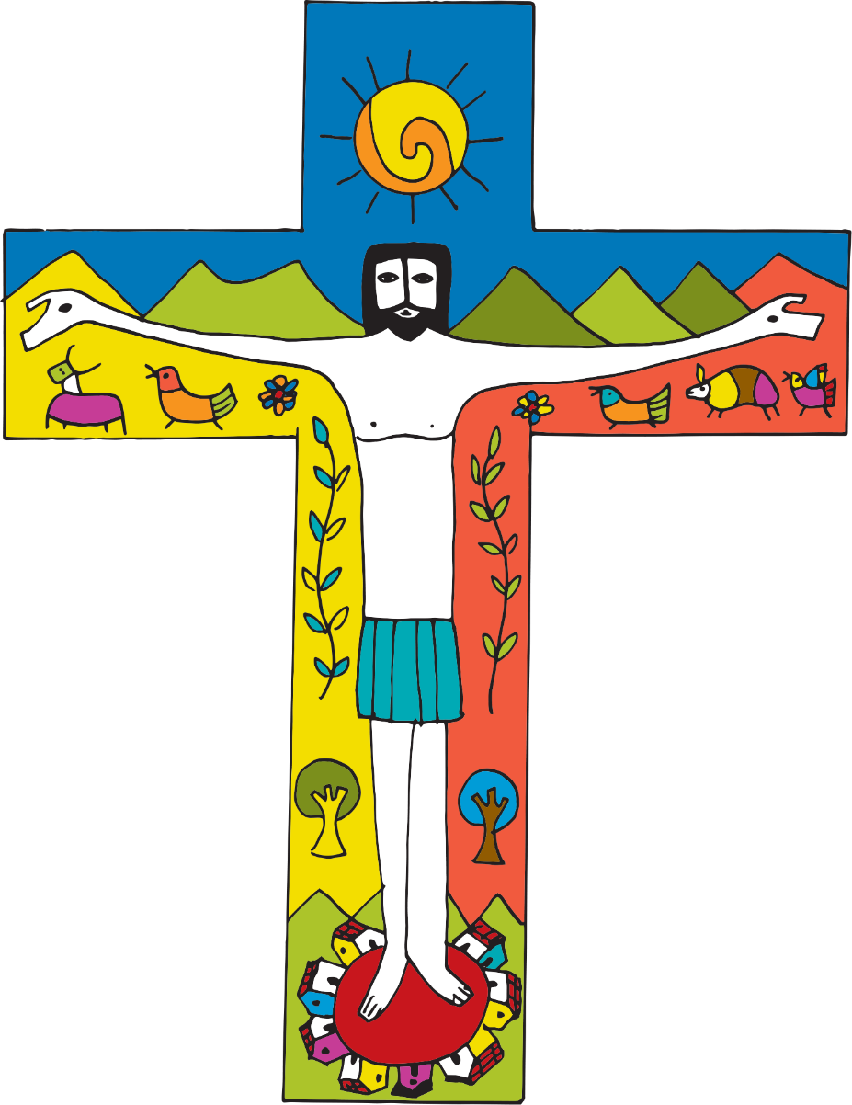
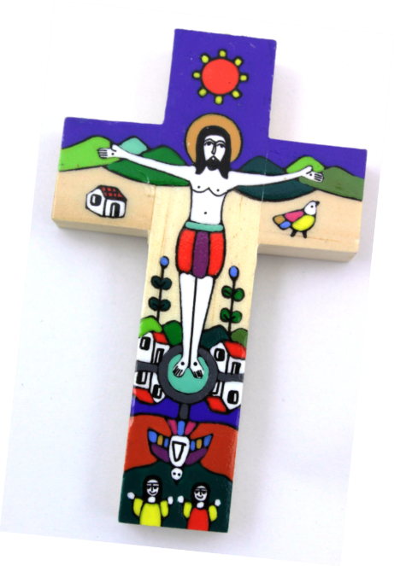
What is a Romero cross?
What can you see on the cross?
What do you think the pictures mean?
Notes:
In El Salvador, there is a tradition of producing colourful crucifixes. The bright decorations have a figure of Jesus at the centre but also include images of the local community set in a Salvadoran landscape. They have become known as Romero crosses in England and Wales.

Slide 4
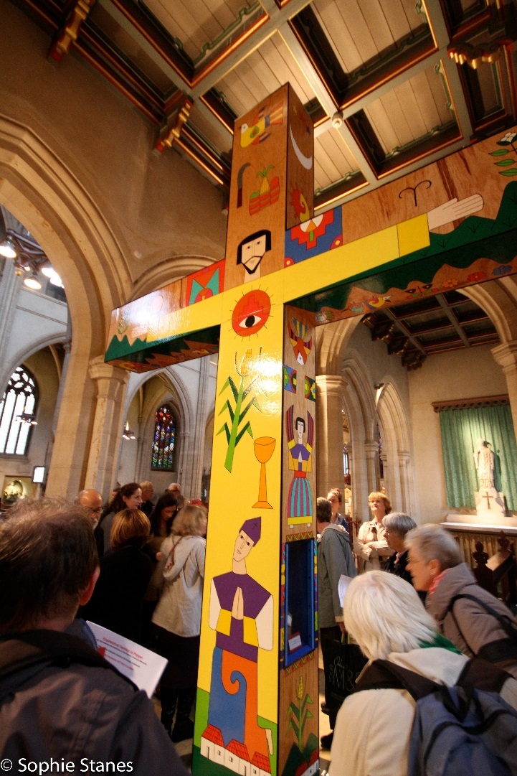
Fernando Llort’s Romero cross
Notes:
The photos show the Romero cross that stands in Southwark RC Cathedral in London. The cross was designed by the artist, Fernando Llort, in memory of his friend Romero.
What do you think the cross shows? (You may wish to discuss this with the children, before sharing the information below).
One side is the Cross of Ministry. You can see Jesus with raised arms greeting the crowd of 5,000. Above them are the loaves and fishes. Below is a bishop with his people representing Jesus’ continuing ministry. Above this scene, you can see mountains in the background of the Last Supper. Above Jesus are the bread and cup of communion. Over these is the Tree of Life, and at the top hovers the Dove of Peace, the Holy Spirit.
The other side is the Cross of Resurrection. The Risen Christ greets the world. The eye on his breast is that of God the Father. Beneath it, are a stalk of maize and a cup of chicha, a harvest drink – these symbolise the Eucharist. Archbishop Romero stands above a village, symbolising his pastoral concern and his own resurrection through death in Christ. Above Jesus are a machete and the gathered harvest, representing the dignity of work and the fruits of labour. Again, the bird at the top symbolises the Holy Spirit.
More of Fernando Llort’s design can be seen in CAFOD’s award winning El Salvador Geography education pack for Key Stage 2 – available at cafod.org.uk/geography

Slide 5
Lazaro’s cross
Notes:
Lázaro Rodríguez and his family make Romero crosses and other wooden crafts for CAFOD. They live in La Palma, a town in El Salvador that is famous for this type of work.
Lázaro says: “I am very happy that the work with CAFOD is increasing. Having work means that we have enough money to sustain ourselves and cover our basic family needs. For me, CAFOD is our right arm, helping us to survive, because what we earn from you enables us to support our family. I get worried when you ask us for large orders, because of the responsibility, but what we do is to involve more people. I say to them Come on, let's work together. We are always careful to employ people we know and trust, family members, cousins, nieces and nephews, in-laws and godparents. We try to coordinate our work carefully and go slowly to ensure a good result.”

Slide 6
Design your own Romero cross
Notes:
Design your own cross. Include drawings or cut-out photos for your own school, parish or other community. Think about the background landscape, colours that reflect your surroundings and which aspects of your community’s life to include.
A downloadable template is available at cafod.org.uk/primary/romero
Display your crosses in your classroom or school hall to celebrate Romero’s beatification. Send photos of your class display to us at schools@cafod.org.uk

Slide 7
Romero cross activity
Photo credits: Equipo Maiz, CAFOD, Sophie Stanes

