Slide 2
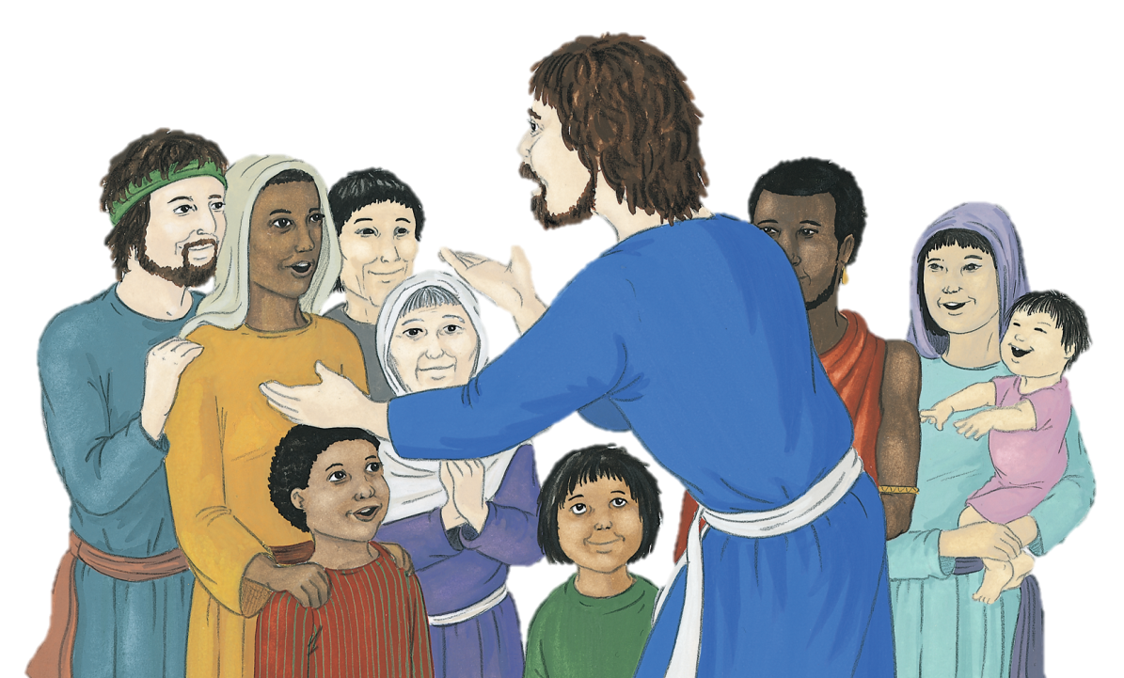
The friends of Jesus were full of new life and could not stop telling everyone about Jesus. Their minds and hearts were full of all he had done
and said.
One day they had Peter and John arrested and put them inprison.
The next day all the council officials assembled and had Peter and John brought before them.
When they went to the temple to pray they talked to people and crowds gathered round them. They helped the poor and the sick.
“We’ve heard that you are going about preaching
about Jesus and healing. What right do you have to do this?” they asked.
Some of the officials in the temple were very annoyed about everything that
was happening.
Peter and John were not afraid, “Whatever good we do,” said Peter,

Slide 3
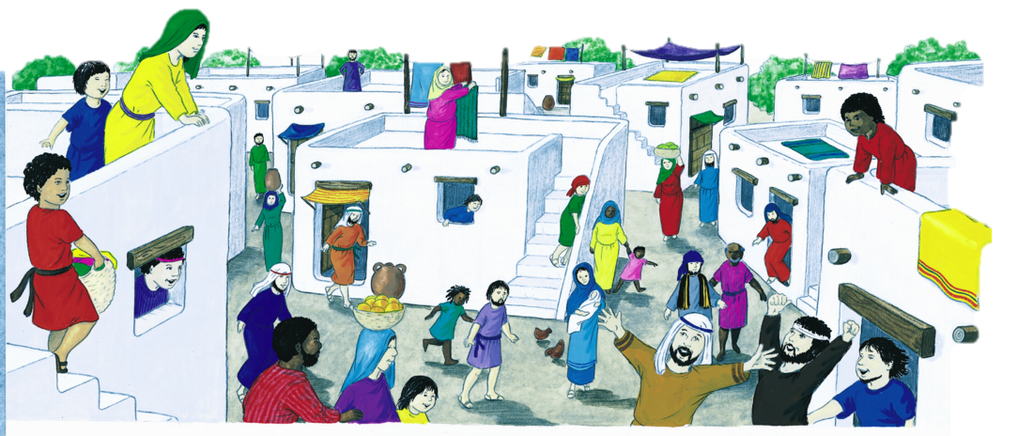
“we do in the name of Jesus Christ of Nazareth. You crucified him, but God raised
him from the dead.”
“We cannot keep silent about the great things that God has done. We have to
spread the Good News of Jesus.”
The whole council were amazed that two very ordinary men were not afraid, and were able to speak out boldly.
The officials had to let them go because the people were so glad about what they were doing, and the officials did not want to risk a riot.
They discussed the matter, and then ordered the disciples never to speak or teach in the name of Jesus.
When Peter and John got back to the other disciples, everyone thanked God for their safety and the courage that the coming of the Holy Spirit had given them.
But Peter and John were not frightened by any of their threats and said,
Based on Acts 4:1-26
(God’s Story 3)

