Slide 1
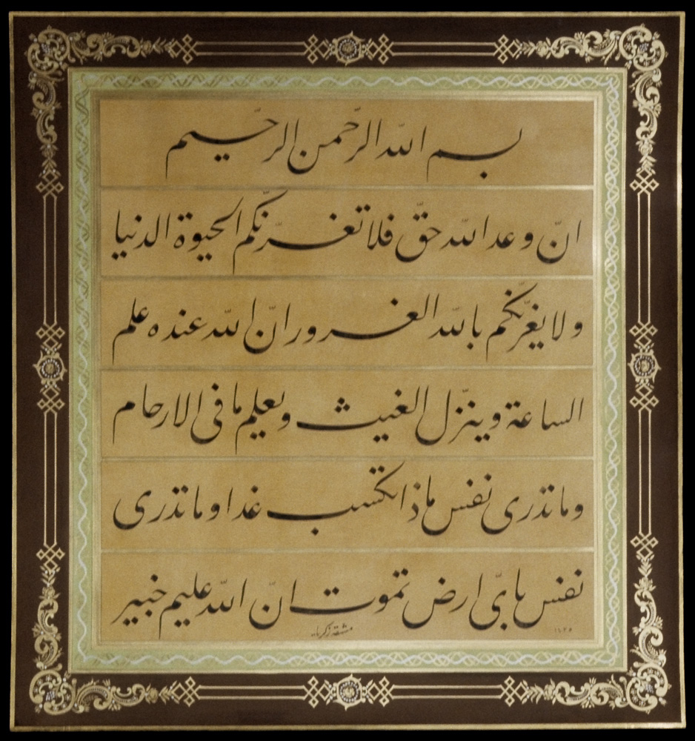
Learning from Scripture
Hinduism

Slide 2
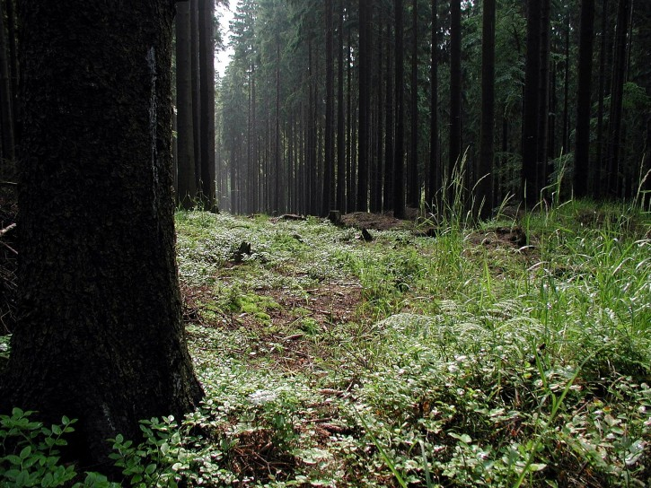
Once there were two sages (wise men) who lived in a forest. They spent most of their time worshipping Vayu, the wind god.

Slide 3
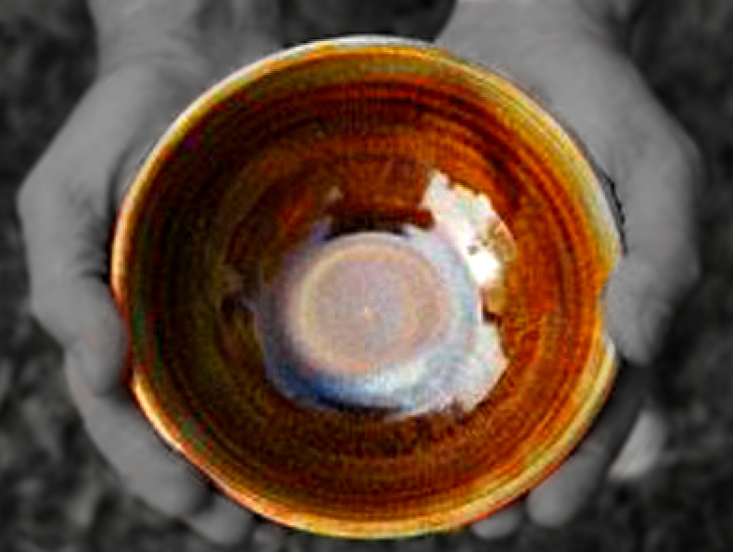
One afternoon, as they were beginning their meal, a young holy man who was a beggar arrived, holding his begging bowl. He asked for some food.

Slide 4
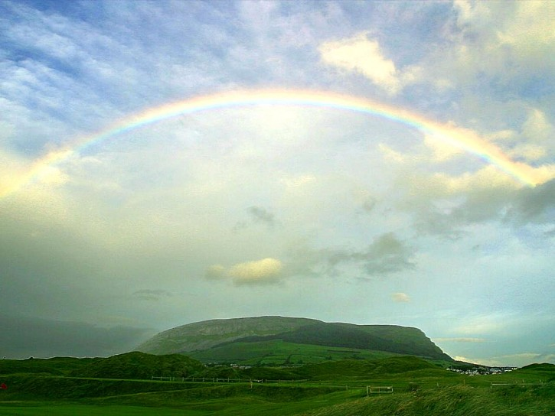
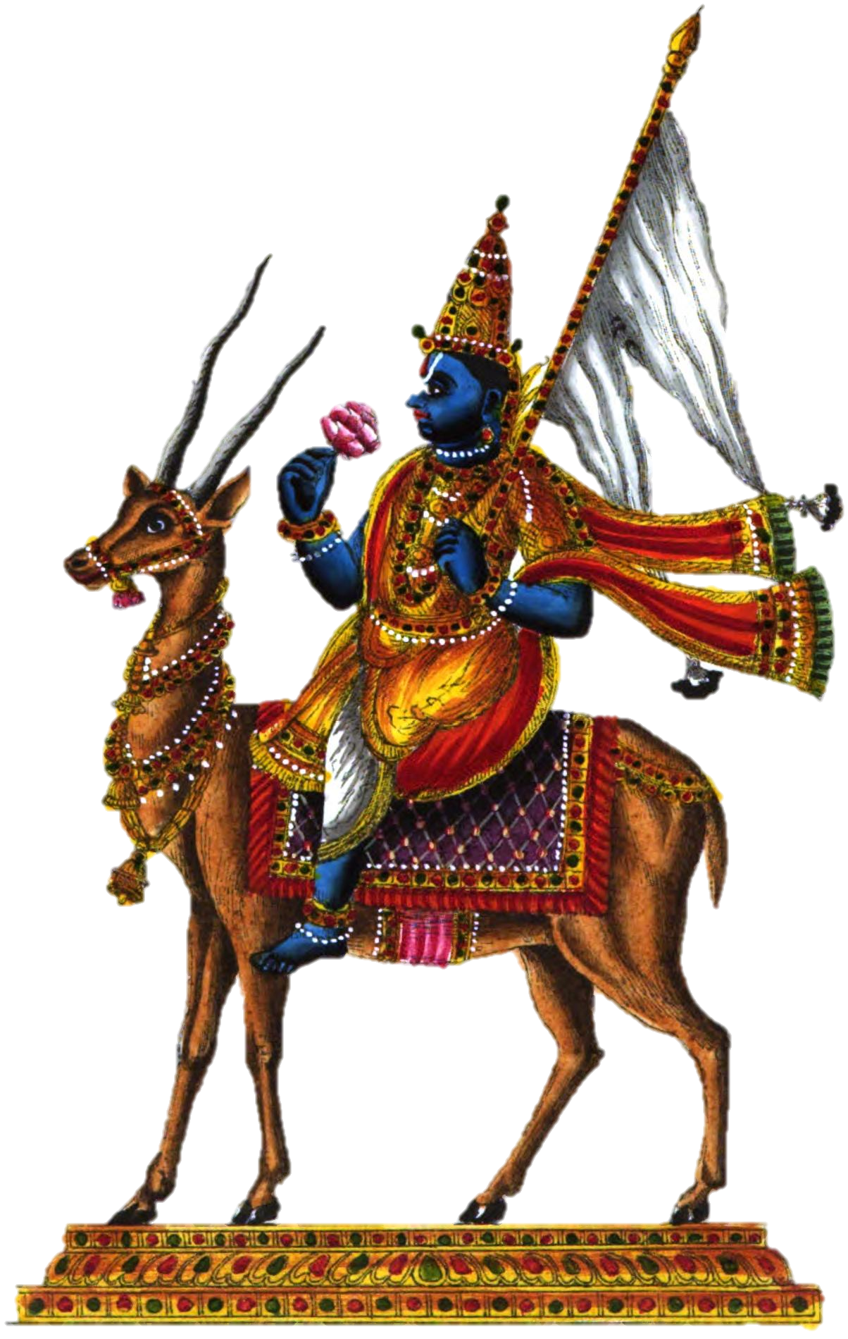
‘No’ replied the sages, ‘we can’t spare any.’
The beggar asked them which god they worshipped. The sages told him Vayu, the wind god, known as the Prana, breath of life.

Slide 5
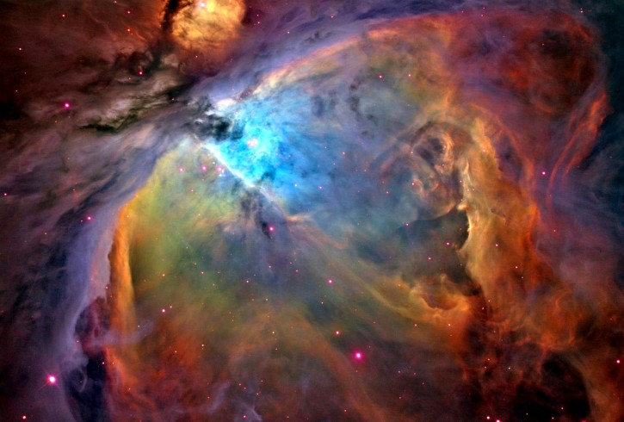
“Ah! Then you must know that “Prana, fills the whole universe” said the young beggar.
The sages were getting impatient, “Yes, yes, we know all that, young man.”
The beggar than asked, “Could you tell me to whom did you make this food-offering?”

Slide 6
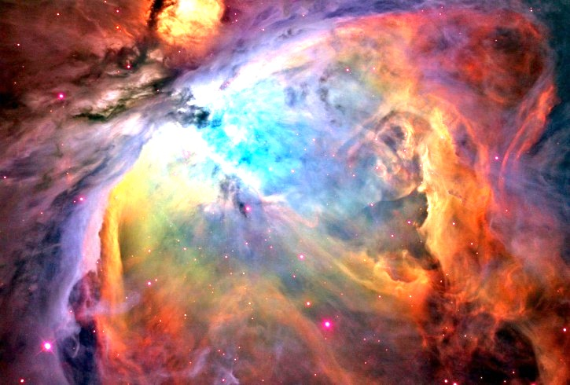
“Prana, the life, who else?” said the irritated sage. The young monk smiled and retorted, “If life fills the universe, it fills me too. Am I not a part of that universe?” “Yes, that’s right” replied the sage, in a puzzled state of mind. “It is Prana, or life, that is in me too,” appealed the beggar.

Slide 7
The sages realised he was speaking the truth and that just reading the scriptures does not make them holy but putting into practice what is read. Ashamed at their ignorance, the sages gladly shared their food with the young beggar.

