Slide 2
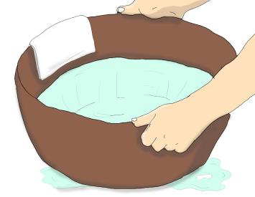
Just before they began their last supper together, Jesus wrapped a towel round himself, filled a bowl of water and knelt before each one of them to wash their feet and wipe them with the towel.
Then Jesus told him, “If I do not wash you, you cannot share my life.”
Peter was horrified and tried to refuse. “You shall never wash my feet, “ he said. This was the service done by the lowest of all the slaves.
At this, Peter said, “Then, Lord, wash not only my feet, but also my hands and my head.”

Slide 3
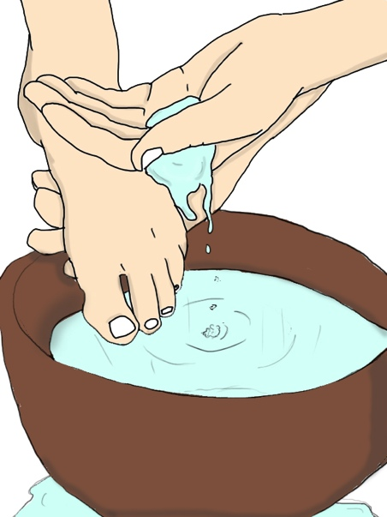
When he had finished, Jesus explained exactly what his action meant.
“Do you understand,” he said, “what I have done for you? You call me Master and Lord, and rightly; so I am.
If I then, the Lord and Master, have washed your feet, you should wash each other’s feet. I have given you an example, so that you may copy what I have done for you.”
Based on John 13: 4-9, 12-15
God’s Story 3

